Slide 1
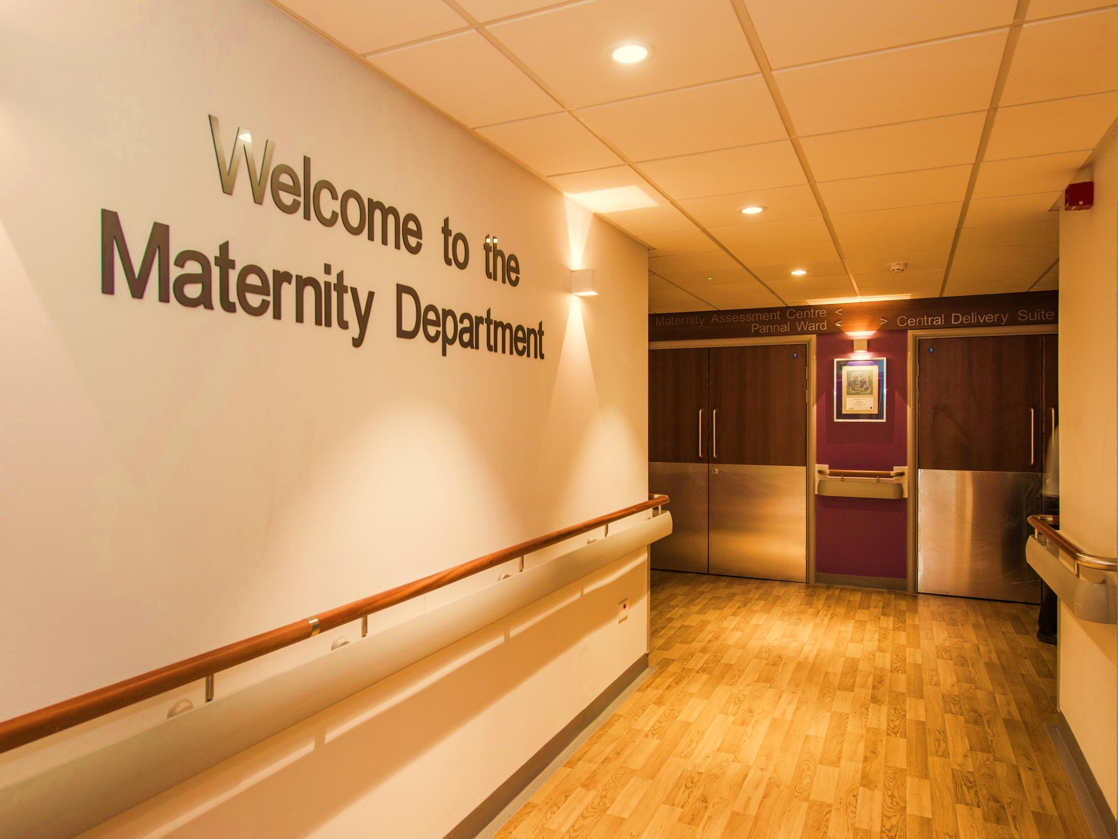
Birth & Beyond
Class One: Active Birth

Slide 2
FYI
We hope you find these modified presentations of help in the current situation of being able to provide Parent Education classes
You can find lots of information on the hospital website www.hdft.nhs.uk (see ‘Patients and Visitors’ and ‘Maternity Services’
Facebook page- Harrogate Maternity- Mums and Midwives, including
a video tour of the unit

Slide 3
Aims & Objectives
Explore scenarios when you might need to come into hospital
Discuss the different stages of labour and how you might feel and experience each stage
Creating the best birth environment for you
Discuss techniques for coping at home
Moving for birth
Birthing your baby & the immediate postpartum period

Slide 4
How will I know if I am in labour?
Contractions? Show? Waters breaking? Diarrhoea?
What do you think they mean?
What might you do?
If in doubt- Call the Midwife for advice
Warning: Photos coming up!
Notes:
How will I know I am in labour? Contractions? Show? Waters breaking? Diarrhoea?
Contractions? Feeling the abdomen tighten for perhaps between 20-60 seconds then relaxing, perhaps with some backache or period like discomfort.
If over 37 weeks, baby known to be head down and happy with your babies movements and coping then await events. Listen to your body, rest if you feel like resting, be active and move around if you can’t rest. Distract yourself, try not to ‘watch the clock’- perhaps go for a walk or watch a comedy on TV, relax in a warm bath, ask your partner to give you a massage, listen to music. You may want to use a TENS machine (see later slides) or bounce on your birthing ball if you have one at home. Perhaps try a 1g dose of paracetamol (doses spaced at least 4 hours apart, maximum 8 tablets or 4mg in a 24 hour period).
Its important to keep well hydrated, water, isotonic drinks or tea, snacks like fruit, cereal, crackers, toast, a few sweets to give you bursts of energy. You are unlikely to fancy a 3 course dinner! If you feel nauseous keep hydrated by taking plenty of sips, if you are sick which is common in labour, then it is important to replace the fluid you have lost once you feel able to. Bladder care is important too, sometimes the sensations of birth can affect our normal feeling of needing to wee, an emptier bladder gives our baby plenty of space to move into a position for birth. Your partner can remind you every 3-4 hours to try emptying the bladder.
If less than 37 weeks, baby in the breech (bottom down) position, concerned baby's’ movements are reduced, not coping with discomfort or coming regularly (3-4 in a 10 minute period, each lasting near 60 seconds and like this for longer than an hour), then call and let us know and we will give advice.
Your partner may help you monitor the frequency of your contractions, encourage hydration, snacks, run you a bath, offer a massage, remind you to take rest, support you in active birth positions or offer doses of paracetamol (as above maximum dose warning).

Slide 5
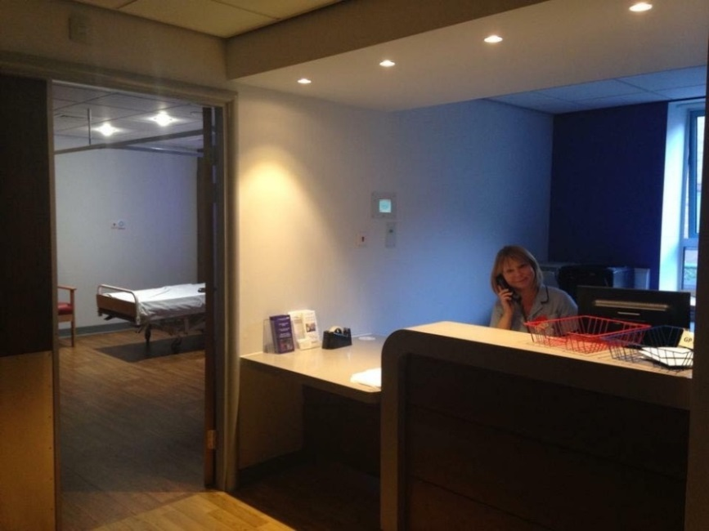
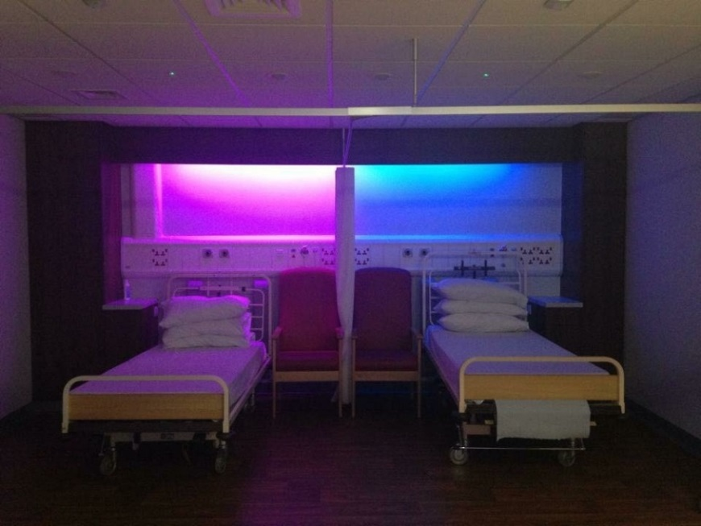
Who should we call? Maternity Assessment Centre (MAC)
Situated on the 1st floor of Strayside Wing, next to Pannal Ward
Open 8am-8pm, Monday to Friday
Delivery suite when MAC is closed
Notes:
It is always best to call so we can give you advice specific to your pregnancy based on how many weeks you are, any medical conditions, your baby's movements and scans etc., much better than resorting to asking Google, and that is what we are here for! If in doubt, call, we are here 365 days a year, 24 hours a day.
Always call ahead to let us know you wish to come in so we can allocate you a bed and a midwife to care for you.
When is the right time to come in labour?
If your contractions are coming regularly, i.e., 3 in a 10 minute period, for a couple of hours and lasting 60 second (3,2,1 rule)
If you have concerns about your baby's movements
If your waters are a colour other than clear
If you are finding it difficult to cope with the contractions and need some further support or pain relief
Call us sooner if you are having a home birth so we can arrange a midwife to contact you or straight away if you have had any complications in your pregnancy, e.g. low lying placenta, baby being breech, previous c section, raised blood pressure or mum is known to be Group B Strep (GBS) positive in this pregnancy

Slide 6
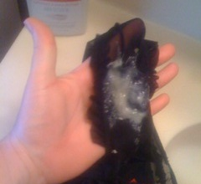
Mucus Plug
What is it for?
Do I lose it all in one go?
When will I lose it?
What does it mean when I lose it?
What does it look like?
Is blood a worry?
Notes:
Having a show (mucus plug)- see examples above. This plug of mucus sits within the cervix, which remains tubular in pregnancy (tucked backwards slightly, 4-5cm in length and approx. 1cm thick), having a show is a sign the cervix is making some changes for birth (moving forwards, losing length, thinning and softening)- this process is called effacement.
In our first pregnancies this process must complete before the cervix can continue opening or dilating, this latent part of labour can be an indeterminate amount of time- ‘how long is a piece of string?’- may be hours, days or longer.
In subsequent pregnancies the cervix has some ‘muscle memory’ of having done this before so typically can efface and open at the same time, which generally follows that our second labours are shorter in length. What to do- if 37-42 weeks, get excited, a sign that your body is preparing for birth, but this can still be hours, days or a week away! You don’t need to let us know UNLESS you think you have had a show and are less than 37 weeks into your pregnancy
It may be streaked with blood or even quite pink/red in colour, any bleeding that is not mucousy, or is mucousy but very heavy needs investigation
It may come away all in one go, or may keep coming away, particularly as you wipe after passing urine

Slide 7
What do I do when my waters break?
When will my waters break?
What colour might they be?
What is Meconium?
What do I do if they break at home?
Notes:
Your waters may break before labour, during labour or the baby may even be born in the bag of waters.
They are typically clear in colour, sometimes with small white flecks.
You may have a fore water break (often like is portrayed in films!) and it is very obvious OR you may have a hind water break, this can be less obvious- perhaps as a small gush then further small leaks or perhaps just feeling damper than normal and needing to wear a sanitary towel. Either way it is the waters breaking (SROM- spontaneous rupture of membranes).
If you are less than 37 weeks and no sign of contractions, we ask you to come in so that we can confirm whether your waters have broken or not. If you are over 37 weeks, the majority of women (60%) will start in their labour if we wait for 24 hours, if you are happy with your babies movements and some basic checks are normal then we would encourage you to go home and await events. We will give you some paper thermometers to use at home every 6-8 hours to monitor your temperature. We advise you to use sanitary towels and change them regularly, not avoid intercourse and swimming (it is alright to bath in plain water). If your temperature is rising, if you feel unwell in anyway, if the colour of the water changes or you have concerns about your baby's movements feeling reduced we would ask you to come back in. After 24 hours if your labour has not started we will discuss with you if you wish Induction of Labour (IOL) or whether you wish to wait a little longer.
If the waters are black/brown/green, an example on the next slide (this means your baby has passed meconium- its first poo) or heavily pink or red (blood staining) and we need to keep a closer eye on your baby by monitoring its heartbeat. We are likely to admit you so we can keep a close eye on you and your baby's well being. This also applies if Mum is known to be Group B Strep (GBS) positive in this pregnancy as we are likely to start your intravenous antibiotics once the waters have gone.

Slide 8
Meconium Stained Liquor
Notes:
If your baby has passed meconium before birth we do a set of observations of heart rate, breathing rate, oxygen saturations, temperature and general well being on your baby at 1 and 2 hours old (baby stays with you).
If the meconium has been significant we continue these observations every 2 hours until your baby is 12 hours old.
It is quite common for your baby to pass meconium before birth if the of overdue, but we would still follow these same observations.

Slide 9
Reduced Fetal Movements
Feeling your baby move is a sign they are well
Your baby will have its own pattern of movements that you will get to know
A reduction in movements can be a warning sign that baby is unwell
You should be able to feel your baby move right up to the point of birth- it is NOT true that their movements slow or stop
Any concerns- act straight away, do not delay, we are here 24/7
Please never use a home Doppler- you don’t know what you are listening to and this is not a thorough enough assessment!
Notes:
Any concerns about your baby's movements need investigating properly, listening in for 1 minute like your midwife does at you’re an checks is not a sufficient enough assessment of your baby's well being.
We ask that you come to hospital so that we can perform continuous monitoring (CTG) for a period of around 30 minutes, this gives us much more information on your babies well being and assures us baby is well now.
It does NOT predict about tomorrow or later in the week, if concerns continue then you need to re attend again at the time you have concerns.
Repeated episodes of reduced fetal movement will warrant further assessment, e.g., growth scan, Doppler's and liquor volume.

Slide 10
Diarrhoea and Vomiting
Ask yourself:
-do I feel well in myself?
-am I happy my baby's’ movements are normal?
-am I keeping hydrated?
If the answer to any of these is NO then you need to be seen
Notes:
Diarrhoea or a loose stool may be a sign of early labour, it may also just be something you have eaten or a bit of a bug- follow the advice on the slide.
If the answer to ALL 3 of these is YES, stay at home, keep hydrated but do let us know if this changes.

Slide 11
The Labour Line
Notes:
How long may labour be?
Every pregnancy is unique and generally our body will work at the pace that is right for you to birth your baby, it is difficult to make comparisons to other peoples births!
As discussed already, the start of labour is the ‘piece of string’- hours, days, as the cervix makes the changes for active or established birth, by moving forward, losing its 4-5 cm length, thinning and softening, as it completes this it then opens or dilates to around 4cm. In class we would normally get you to use a balloon and ping pong ball to help you understand this, which is great fun! You can search You Tube for – Liz Chalmers- Using balloon and ping pong ball to show how the cervix thins and dilates in labour which gives a good demonstration of this. In this early phase of birthing, contractions may be a bit stop/start- it may seem like they are starting to come more regularly then the space apart again, this is really normal, perhaps your body signalling to you to rest or to try something to eat and drink.
10cm is the point that the cervix has opened fully and now the baby can move down the birth canal,4cm-10cm or the active part of the birth process may take between 6-12 hours, some women take a little longer, others take less time than this. Continue doing all the things you did during the early stages- keep active, hydrated, snack, bladder care, using TENS, paracetamol, the birth ball, take slow smooth breaths, massage from your birth partner, music.

Slide 12
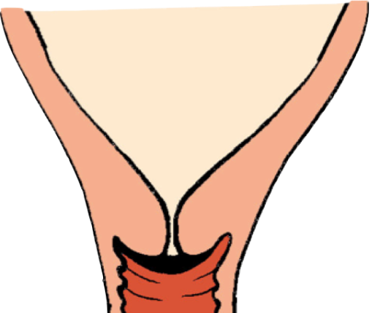
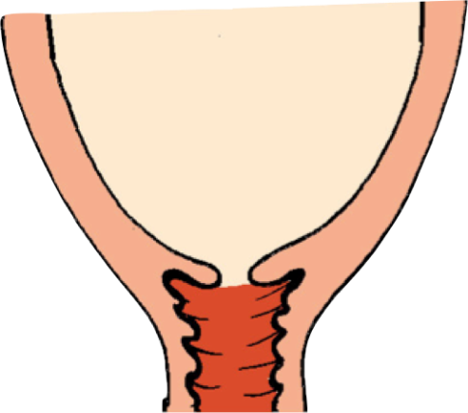
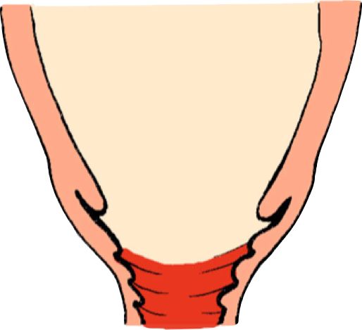
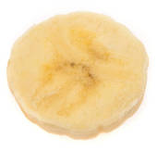
What changes are happening inside my body? Cervical Effacement & Dilatation
1cm
3cm
4cm
7cm
10cm
Notes:
Visual references
– pulling on a polo neck jumper
-Sucking a Polo mint – the mint becomes thinner, and the hole in the middle becomes bigger
Pictures of real life objects to help to visualise cervical dilatation.

Slide 13
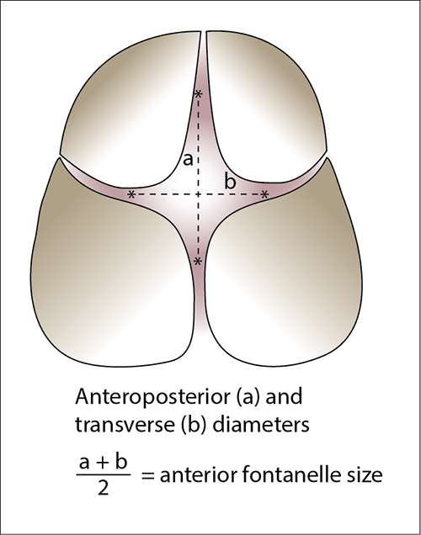
Our clever design!
As we keep active and upright, we may increase the space in the pelvis as much as 28% for baby to birth, making birth comfier and shorter
Our baby is designed to fit too! The baby's skull bones gently overlap during the birth process, making their head physically smaller to birth- amazing design!
Notes:
In pregnancy, the hormones help to soften the ligaments and loosen the pelvis, by getting into positions where our hips are apart and we are upright we are already creating a bit more room and gravity is on our side.
Keeping the bladder empty enables more space for our baby to get lower into the pelvis.
A birthing ball can help us get into active positions and help us feel comfier, if sat on a birthing ball you need to use the correct size for you- the angle from hips to knees should be a minimum of 90 degrees.
The baby's skull is not one fixed bone and takes until the baby is nearer 2 years of age for the skulls bones to fuse fully, the soft space between the skull bones is called a fontanelle, there is one at the top of the skull and a smaller one at the back

Slide 14
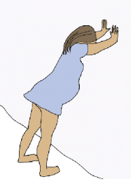
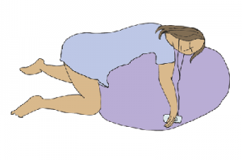
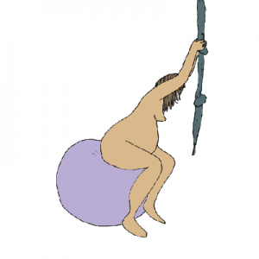
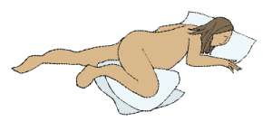
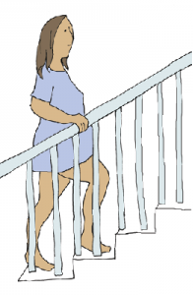
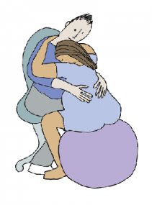
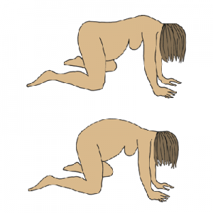
Why is it beneficial to remain Active in Labour?

Slide 15
How to Create the Best Birthing Environment for You…
Birthing at home or hospital?
Notes:
Where are you planning on giving birth- home or hospital?
Home birth is a safe choice for many women who have had no health concerns for Mum or baby in their pregnancy who chose to birth in a familiar environment with the support of midwives.
Evidence suggests home birth may increase the chances of normal birth and reduces the risk of intervention and for pain relief.
You may have decided earlier in your pregnancy that you wanted to birth in hospital, but you may review this decision as your pregnancy progresses and you explore home birth as an option. Please feel free to discuss your options and obtain more information from your midwife.

Slide 16
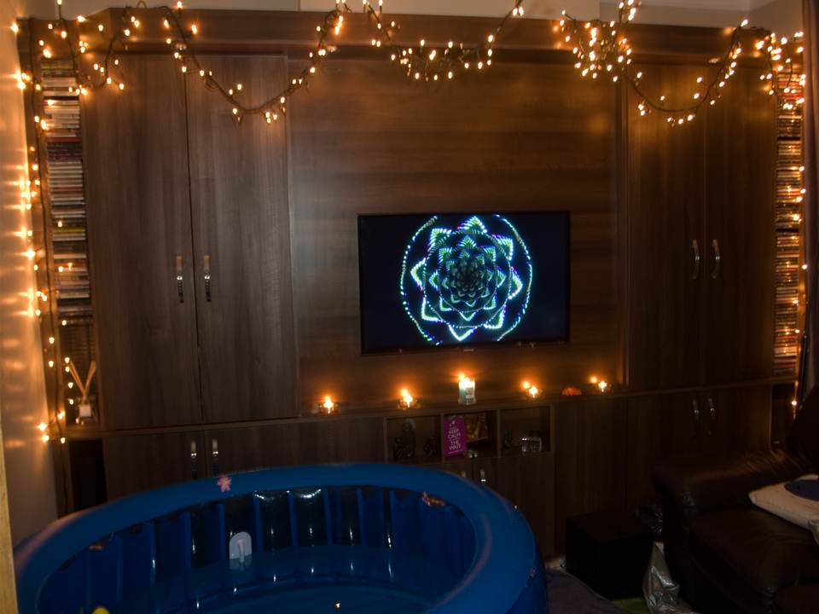
Create an environment that makes you feel safe, secure & comfortable both when you are at home….
Notes:
Whether you choose to give birth at home or hospital, the birthing environment can play a big part in helping us feel more comfortable and relaxed, and help our balance of birthing hormones.
Oxytocin is the hormone produced in rhythmical waves to give contractions, alongside our body produces endorphins- like our own natural mechanism to help the body feel comfier as it works hard, as it is perfectly designed to do. Using a TENS machine boosts our bodies production of natural endorphins.
Lighting is really important, in dim lighting or darkness our body increases production of melatonin, which supports the activity of oxytocin and endorphins- this is why many births start in the night. Maintaining dim lighting by using lamps, candles (or battery operated candles or fairy lights in a hospital setting).
At home we are likely to feel at our most relaxed, safe and secure with all our home comforts around us and the support of your birth partner
Adrenaline, the hormone we increase production of when we are fearful or anxious can interfere with the birthing process as it dampens down the birthing hormones, which may lead the birthing process to halt as our body goes into a natural defence mechanism. If we look to how other animals chose to birth, a cats owners’ may have prepared a box with soft towels next to a radiator, then find the cat has birthed their kittens under the bed in the spare bedroom. The cat chose to birth in a place that they felt most safe, without interruption or feeling observed, likely helping their birth to progress more efficiently and comfortably.
In addition to lighting, think about other factors in your birthing environment you can control that may help you feel more comfortable and relaxed
Supportive birth partner
Warm bath
Comforting scents, perhaps aromatherapy oils, your favourite perfume, reed diffusers
Music, perhaps the choice of both something you find relaxing or something more upbeat that helps with distraction or feeling exhilarated as you sing and move around to it or bring back memories of what that music means to you
Perhaps a soft comfy pillow to rest against at the times your body is signalling to you to rest
Use of massage, perhaps back, neck shoulder or you may enjoy a hand or foot massage
Wear whatever you feel most comfortable in
Perhaps have a photo of baby on scan close by to remind you what this is all for meeting your baby

Slide 17
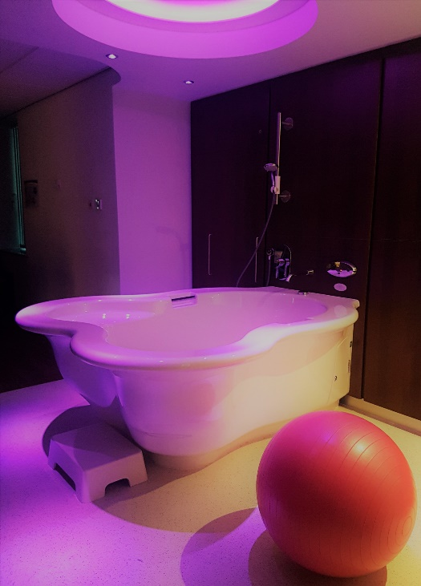
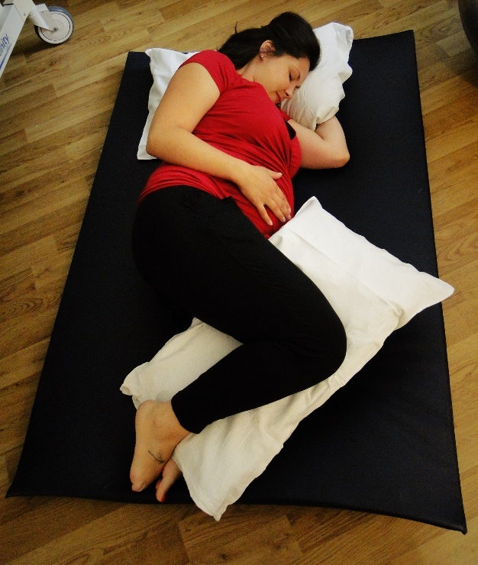
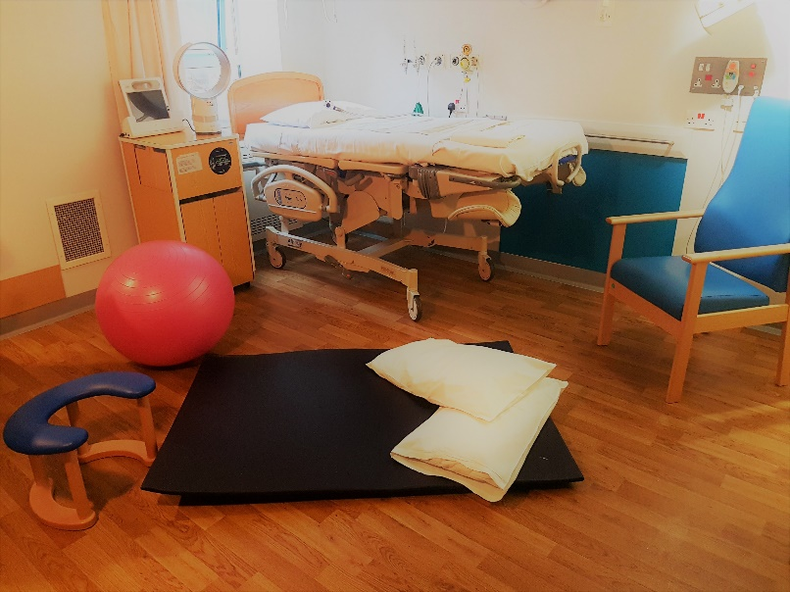
and in hospital…building a ‘nest’
Notes:
If you are choosing to birth at hospital, its important to consider ‘building the nest’ for you in this new environment.
One of the biggest advantages of home birth is that you don’t need to then leave your nest to move to another that may be initially unfamiliar, many women may find that leave home with regular contractions, then as they arrive at hospital, their contractions may have slowed down, this is because they have likely had a peak of adrenaline that has dampened down oxytocin. As they begin to feel more comfortable and relax in their new environment, their birthing body will continue.
Birth partners have a massive role to play here in understanding how important it is to ‘build the nest’ in the hospital setting. Bring in form home all the items mentioned on the previous slides, there is nothing lovelier than a room lit be fairy lights. Ask the midwife if you wish to rearrange the room , perhaps move the bed against the wall, pumped high so that your partner can use it as support while she keeps active and upright or rest her head onto a pillow you’ve bought in from home between her contractions. If you wish to use a birthing ball, mats, etc. and there aren't there ask the midwife to find you one. The bed can also be adjusted to help support your partner into comfy active positions like an upright all fours position.

Slide 18
Low Lighting – LED candles, fairy lights
Massage
Supportive Birth Partner
Exploring your fears now
What can help to keep me calm during my birthing?
Hypnobirthing
Self Belief
Positive thinking
Relaxation
Deep Breathing
Notes:
Positive thinking and self belief is so important in the approach to birthing – encourage a positive mind set for both you and your partner, we are designed to birth and if we prepare with confidence this helps.
Breathing, its so important! Long, slow, smooth breaths in and out, the uterus (womb) in a muscle, the more oxygen we take in by breathing well the comfier it will feel. It really is possible to prepare well by think about their breathing in the approach to birth, taking just 10 minutes out each day just to sit quietly and focus on a slow, deep, steady breath, even if this is just at the end of the day as you both get ready for bed. Taking a slow deep breath helps to release tension, refocus the mind and relax, your breathing will become more efficient and this also gives your opportunity to enjoy some time for relaxation each day. Imagine as you concentrate on your breath that each muscle from the top of your scalp to the tips of your toes is relaxing, as the whole body relaxes in birth, your body works at its most comfortable without us tensing. Holding your breath and tensing or breathing too rapidly does not help the birthing process to feel its most comfortable.
Massage – helps to connect the birthing partner and woman, reduce tension, increase circulation and can help with relaxation. Take the time in your pregnancy to practice what feels nice, enjoy practising on each other and trying different techniques. At the time of birth, women may change their mind in labour and prefer not to be touched, so it is important to check that she is still finding massage of help as the birth progresses.
Hypnobirthing – you may wish to explore the on line options for this, many women successfully ‘hypnobirthing’ without ever attending a course, some without even reading or practising as it is just instinctively how they choose to be.

Slide 19
TENS Machine
Paracetamol
Warm Bath
Coping and keeping calm
Rest when needed
Massage
Deep Breathing
Graze on food & drink
Mobilise & Change Positions
Notes:
Click once to bring up “coping at home”.
Click again to reveal answers.
Ask the group for ideas of things they might do at home to help in the early stages of labour.
Discuss in more detail as follows…

Slide 20
Paracetamol
1g (2 tablets) 4-6 hourly
Maximum 4 doses in 24 hours
May help with lower back ache & period type pain.
Birth partner- helpful to keep track of how many doses taken, when next due etc.
Notes:
It can be helpful that your birth partner keeps track of when you take it, when another dose could be taken and relay this to the midwife so we know if you can take any more whilst caring for you.

Slide 21
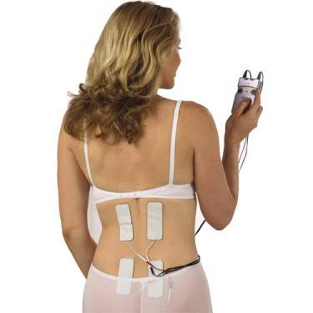
TENS Machine
Transcutaneous Electrical Nerve Stimulation
Thought to stimulate the release of endorphins
Also helps to reduce the number of pain signals sent to the brain
Most effective in early labour- best started at home
Controlled by the woman
Can act as a distraction.
Notes:
The evidence for use of TENS in birth is not conclusive, but it is thought to help reduce pain signals sent to the brain and to stimulate the release of endorphins, likely more beneficial in the latent or early phase than active phase.
Benefits include being non invasive, having the option to remove whenever desired, patient controlled so helps the woman to feel in control.
TENS can be hired or bought, its worth a try so that is another option available to you. If using it is worth becoming familiar with how to operate, your birth partner to be familiar with how to help you apply it rather than waiting until the time you want to use it. TENS machines should not be use before birth.

Slide 22
Warm Bath
The warm water can help to soothe and relax you
You may feel less tense
Warm water can help to relieve pain
In the early phase a warm bath may slow contractions down and give you a break.
Notes:
Resting on your side in the bath, perhaps with your top leg turned out to not restrict the coccyx bone of the pelvis being able to move and the pubic ligament widening the pelvis.
If you think your waters have gone not to put any oils or other products in the water.

Slide 23
Transition
Typically occurs between 8-10cm dilated
You may feel like you are losing control
You may feel like you’ve had enough and want to go home!
A supportive birth partner is very important at this stage- major cheerleading pom poms and a thick skin helpful!
This is a completely normal stage of labour
Remember… Its almost time to meet your baby!

Slide 24
2nd Stage
From full dilatation (10cm) until the birth of your baby
Often accompanied by a strong urge to push or a pressure in your bottom as the baby descends further
You may experience a passive 2nd stage before the urge to push arrives- this is normal
During the 2nd stage it can take a first time mum up to 2 hours to birth her baby
The baby descends slowly round a bend created by the coccyx; upright & forward leaning positions can help this
Crowning occurs as the widest diameter of the baby’s head is born, your midwife will guide you to breathe slowly during this stage.
Notes:
Your midwife will be looking for signs that your body is ready to birth, and will encourage you to listen to your body and take its direction sometimes if your baby is in a posterior (back to back position) or your baby is breech (bottom first) the midwife may ask to check that the cervix has fully dilated.
Maintain a position that you find most comfortable to be in, active and upright positions normally work best. You may feel pressure in your back passage as baby is moving down and around the birth canal. Your body may open the bowels (poo) at this point, is this a very reassuring sign that everything is happening as it is perfectly designed to do, you may not even realise this has happened as the midwife discreetly clears anything away.
At the point of crowning the midwife will ask your consent to support your perineum (the area between the vagina and your back passage) by holding a warm compress against it, the latest evidence that suggests this help to reduce the risk of tearing in this area. If you are using the birthing pool then the water pressure and warmth does this, Your midwife will be watching and feeling how quickly the baby is coming forward and may ask you to resist your body's instinct to push and to blow out (imagine blowing out candles on a birthday cake of blowing bubbles). This allows the power of your contraction alone to birth your baby, again reducing the chance of a tear.

Slide 25
Perineal Massage
Perineal Massage from 34 weeks of pregnancy has been associated with:
An overall 9% reduction in the incidence of tears requiring suturing in first time mums
16% less likely to have an episiotomy
Multiparous women are less likely to report pain 3 months after birth
How often do I perform perineal massage?
From 34 weeks
Minimum of 1-2 times per week
For 5-10 minutes each time
When shouldn’t I perform perineal massage?
Before 34 weeks
If you have thrush
If you have any vaginal infection
History of genital herpes
If you think your waters have broken
Leaflet available at www.hdft.nhs.uk
Notes:
Perineal massage is a method for preparing the perineum for birth, you may wish to try, there is good evidence to support it. There is a ‘How to do’ on the Patient Leaflets section for Maternity at www.hdft.nhs.uk
You may practice this regularly and have a tear, you may not do it at all and not have one.

Slide 26
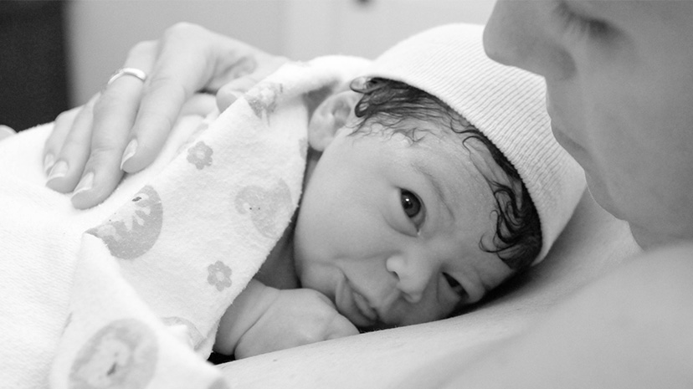
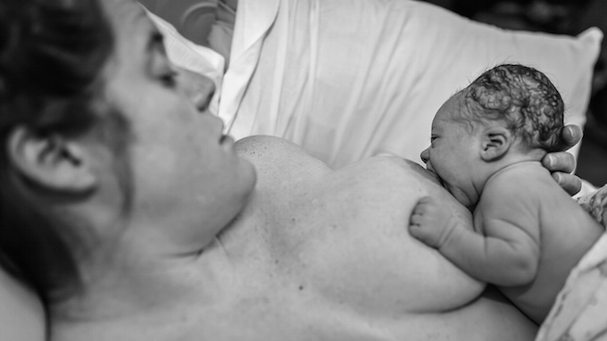
Skin to Skin
The 9 Instinctive Stages:
Birth Cry
Relaxation
Awakening
Activity
Resting
Crawling
Benefits of Skin to Skin:
Helps to regulate your baby’s heart rate, breathing & temperature
Helps to stabilise your baby’s blood glucose levels
Significantly reduces levels of stress hormones & reduces crying
Bonding & Attachment –stimulates the release of oxytocin
Helps to initiate breastfeeding
Familiarisation
Suckling
Sleeping
Notes:
However you baby births, however you intend to feel your baby, we recommended uninterrupted skin to skin contact with mum until the baby has taken their first feed.
1st stage: The birth cry occurs immediately after birth as the baby's lungs expand but usually ends abruptly when the baby is placed onto the mother's chest.
2nd stage: Relaxation begins when the birth cry stops and usually lasts 2–3 minutes during which the baby is very quiet and still.
3rd stage: Awakening begins with small head movements, as the infant opens his eyes and shows some mouth activity.
4th stage: During activity the baby has more stable eye opening, increased mouthing, and suckling movements and often some rooting.
5th stage: Resting can occur at any time between the other stages. Many assume, when babies were resting, that they have given up trying to find the breast and seem to clearly need assistance to breastfeed successfully. With knowledge of the nine instinctive stages, we know this is simply a normal stage and babies will move on when they are ready. Indeed, rushing a newborn to the breast during a resting stage is usually counterproductive.
6th stage: During crawling the baby makes short pushing exertions with his feet or slides his body towards one of the mother's breasts. The baby may lift the upper torso and bob his head in a clear effort to get near the breast.
7th stage: After reaching the breast, familiarization begins and may last up to 20 minutes while the baby becomes acquainted with the nipple by licking, touching and massaging.
8th stage: After adequate familiarization with the new environment and mother's nipple, the newborn opens his mouth wide, cupping the tongue which is now low in the bottom of the mouth, grasps the nipple in a correct latch and begins to suckle This usually occurs about an hour after birth.
9th stage: Sleeping follows usually between 1.5 and 2 hours after birth. Try to then get some rest yourself!

Slide 27
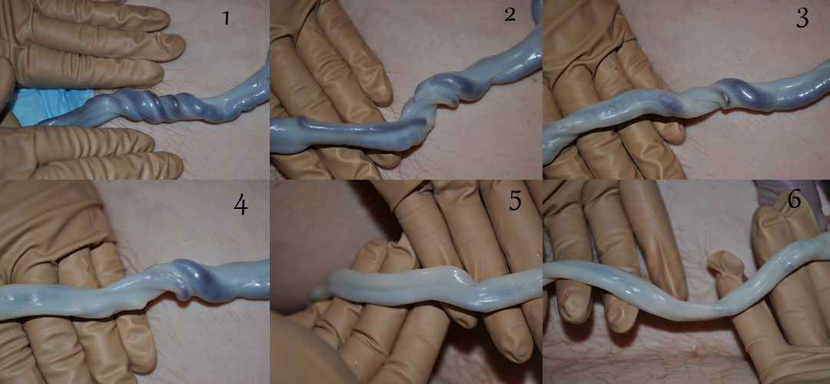
Delayed Cord Clamping
The blood circulating in the placenta belongs to your baby
Delaying cord clamping therefore allows the blood flow to continue between the placenta & baby
The baby can receive up to 30% more blood volume when cord clamping is delayed.
Benefits | Associated Risk
Placenta continues to supply oxygen whilst pulsating | Increased risk from 3% to 5% of needing phototherapy to treat jaundice
Increased blood volume
Increased Haemoglobin levels
Increased iron stores up until 6 months of age
Notes:
However you birth we will try to do delayed cord clamping, even at instrumental and caesarean birth.

Slide 28
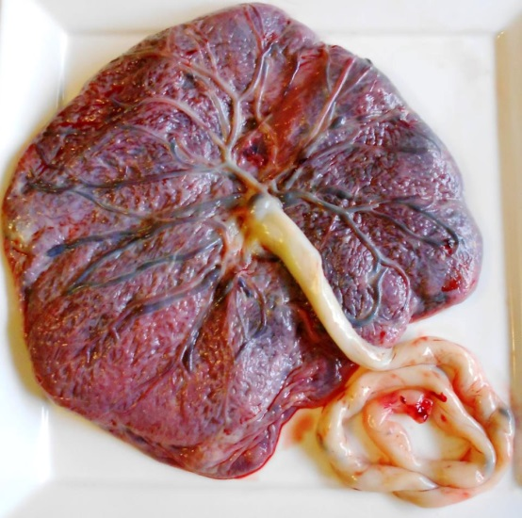
3rd Stage
Physiological Management | Active Management
No routine use of drugs | Routine use of drugs e.g. Syntocinon
No clamping of the cord until pulsation has stopped | Delayed clamping and cutting of the cord (usually between 1-5 minutes but can be left to stop pulsating)
Delivery of the placenta by maternal effort | Controlled cord traction after signs of separation of the placenta
It can take up to 1 hour | Shortens the third stage compared with physiological management
Is associated with nausea and vomiting in about 5% of women | Is associated with nausea and vomiting in about 10% of women
Is associated with an approximate risk of 2.9% of a blood loss of more than 1 litre | Is associated with an approximate risk of 1.3% of a blood loss of more than 1 litre
Notes:
Your midwife during your birth will assess whether there is a good reason for you to have an active management for delivering your placenta, e.g., low iron level, long labour, assisted delivery, we will advise you and explain our rationale for why it has been recommended should this be the case.
If active management is not recommended you may prefer to have a natural or physiological delivery of your placenta. Perhaps you have had an active birth and use the pool, with no drugs or medicines and you wish to complete delivery of your placenta in the same way.
The placenta is an amazing organ, you may wish the midwife to show you it. Unless you have a request to keep it the midwife sill examine it then it is disposed of in clinical waste.

Slide 29
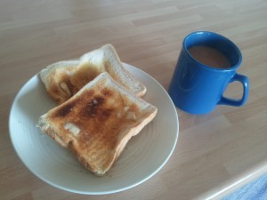
The Immediate Postpartum Period
Assess the perineum & suture if necessary
Following the first breastfeed – Midwife’s Newborn examination, weigh & vitamin K
Tea & Toast!
Shower
Early discharge after
6 hours or transfer to Pannal
if needing to stay in
Notes:
In light of COVID 19, we are no longer able to facilitate visiting in the postnatal period. Partners will be requested to go home as soon as possible following the birth.
Please monitor the HDFT website or our Facebook page Harrogate Maternity Mums and Midwives for the most up to date information.
Amenity rooms are no longer available for booking at the present time. Side rooms will be allocated by clinical need until further notice.

Slide 30
Contact Numbers:
Maternity Assessment Centre (MAC)
01423 557531 / 557548
Labour Ward
01423 553184 / 553185
Pannal Ward
01423 553157
Community Midwives
01423 553051
Harrogate Maternity Mums and Midwives
www.facebook.com/harrogatematernity

