Slide 1
Infant feeding workshop
Notes:
Welcome to the infant feeding workshop

Slide 2
What we will cover
Why we encourage breastfeeding
All feeding options
Skin to skin contact
Feeding patterns
How babies feed
Sleepy babies
Expressing
Problems
Your questions
Notes:
We will be covering the topics above
We have done a lot of work within the unit to support all families with feeding their new babies and have gained a gold award from Unicef for our work – we were the second maternity unit in the UK to achieve this
However we are always listening and learning so if there is anything we can do to support you more please let us know

Slide 3
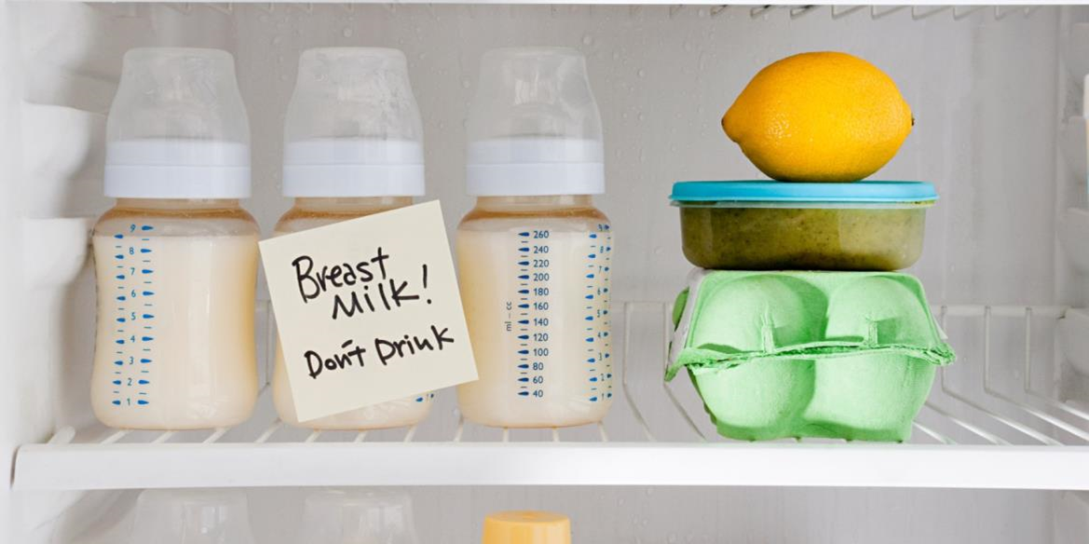
Why we encourage breastmilk and breastfeeding
Notes:
We make no apologies for encouraging you to choose breastfeeding. We will go on to talk more about how it helps protect your baby but it is important to understand that Breastmilk is much more about development than nutrition, formula milk can give the basic nutrition of carbohydrates and proteins but cannot give your baby any of the developmental factors that breastmilk can. This is why any breastmilk you can offer your baby is really important
During the Covid-19 pandemic
There is currently no clinical evidence to suggest that the virus can be transmitted through breastmilk. Infection can be spread to the baby in the same way as to anyone in close contact with you. The benefits of breastfeeding outweigh any potential risks of transmission of the virus through breastmilk or by being in close contact with your child – Public Health England

Slide 4
Adaptation
Notes:
Babies are born before their brains have fully developed. That’s by design, your baby is designed to fit easily through the pelvis as the skull bones gently overlap during the birth process (see Active Birth presentation).
Think about a baby giraffe, how as they birth they manage to get up on their spindly legs and get to their mother to feed. As humans, we are less well developed to walk, but are programmed and developed to find the breast and to feed while in skin to skin contact.
The smarter primates are, the more development they go through after birth , and the longer they stay with their parents
Your milk is made to support this development, it is low fat / high sugar so human babies need to feed frequently
Humans only have 25% of their adult brain at birth so our babies complete their gestation outside of the womb. Breastmilk provides all the components necessary to support your baby’s brain development
During this time they need to be kept close
Babies do not develop their own circadian rhythms (sleep cycles) for months and therefore they do not have long periods of uninterrupted sleep.
This is what ‘sleeping like a baby’ really means!

Slide 5
What's in breastmilk
Growth factors
Hormones
Transfer factors
Bifidus factor
Enzymes
Hormones
Anti inflammatory molecules
White cells
Viral fragments
Oligosaccharides
Notes:
Our breastmilk is amazing and unique, designed to help our babies brains to develop and to grow.
Growth factors help growth and development of the babies gut, the gut is important in our body's defence against bacteria and disease.
Hormones such as thyroid stimulating hormone, insulin, thyroxine, these all support the baby’s immature systems.
Transfer factors help the baby absorb factors in the milk and support the immune system.
Bifidus factor – helps good bacteria and helps destroy bad bacteria
Enzymes – help the baby digest all the nutrients
Anti inflammatory molecules – reduce any inflammation as these go through the babies gut and keep it healthy.
Breastmilk contains the right balance of probiotics and prebiotics that human babies need to colonise their bowels with healthy bacteria
Of the fats in breastmilk, 88% are made from long-chain fatty acids. It’s these long-chain fatty acids that are constituents of brain and nerve tissue, and are needed in early life for mental and visual development
The breastmilk a mother makes for her baby is different on day one, to day seven, to day 30, and so on. For example, the breastmilk made by a mother of a premature baby has different concentrations of various substances to suit her baby’s special needs. And, when weaning, a mother’s breastmilk increases the concentration of immune protective factors to give her baby a final dose of immune protection before weaning is complete.

Slide 6
What's in your breastmilk
+-
Human milk contains thousands of molecules that protect against infection and inflammation.
They mature the immune system and help organ development
Your milk contains Oxytocin, a hormone that induces relaxation, and feelings of well-being in your child and in you.
Your milk appears to switch on a gene in your baby’s body, which produces a hormone called Leptin. This hormone tells your baby when his tummy is full, protecting him against over eating.
Your milk contains ingredients that kill cancerous cells
Your milk contains stem cells. These are cells that create and repair the body, and are being researched worldwide to cure conditions like Alzheimer's and diabetes.
Breastmilk is more than a food its about growth, development and protection
Notes:
Some more interesting facts

Slide 7
Plus - Antibodies
Your body identifies bacteria and viruses and then produces antibodies specifically tailored for those infections. The antibodies are then delivered to your baby through your milk.
Notes:
Your immune system is well developed
When you are breastfeeding you are constantly tracking your surroundings – so if someone comes near you with an infection or virus you will make an antibody to it within 2-4 hours and deliver it in your milk to your baby
If your baby is at nursery – or with someone else, when you see your baby again what's the first thing you do? Kiss, you then track what your baby has been open to and make the antibodies which you deliver in your milk
Clever design!
Many mothers choose to exclusively breastfeeding and that obviously offers the best protection but if your thinking about bottle feeding or mixed feeding, giving your baby any amount of breastmilk every day is amazing. The more you give the more protection your baby recieves

Slide 8
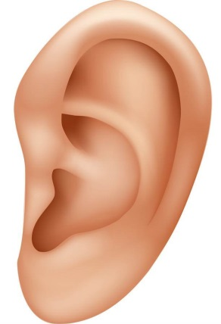
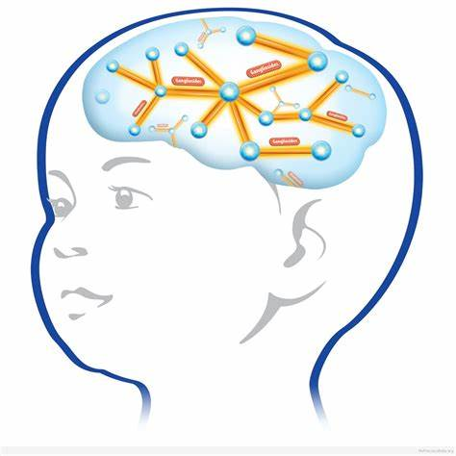
Reducing the risk
Chest infections
Diabetes (by as much as 30% if a family history of juvenile onset diabetes)
Gastro-enteritis
Ear infections
Benefits for Mum include- reducing the risk of breast and ovarian cancer and Type 2 Diabetes
Suggested benefits
also include -
Increased intelligence
And possible reduction in being overweight
“Exquisite personalised medicine”
A gift for life
Notes:
What’s in breastmilk helps to reduce the risk of illnesses in your baby and has many benefits for Mum too.
There are many ‘headlines’ out there with ‘evidence’ on breastmilk, the information here is gathered from the largest review ever conducted – across the world and looked at all the research available, this is not the level of research that the newspapers rely on !
Remember this is reducing the risk – we all know someone who has smoked all their lives and who goes to the pub every day and has lived to 90. Feeding your baby breastmilk has a dose response- the more you give the lower the risk. Even a few feeds of breastmilk can offer your baby some protection.
Admission of babies under a month of age to our paediatric ward with gastro-enteritis and respiratory infections is audited, most of these babies are exclusively formula fed. (this is the same across the UK)
Risk of ear infection for your baby is not only reduced by the antibody protection of breastmilk but also the physical mechanism of how your baby feeds at the breast. The jaw moves and drops, the palate flattens out and the ears drain better than feeding from a teat.

Slide 9
Skin to skin contact
Instinctive stages:
Birth cry
Relaxation
Awakening
Activity
Crawling
Resting
Familiarisation
Suckling
Sleeping
Notes:
For all mums we encourage uninterrupted skin to skin contact at birth, however you choose to feed.
Skin to skin contact is incredibly important for all babies and helps them adapt to life outside the womb, it:
triggers hormones in both of you
calms and relaxes both of you after the birth
regulates your baby’s heart rate and breathing
regulates your baby’s temperature
stimulates feeding behaviour and digestion in your baby
Instinctive behaviours
Babies who are supported to have uninterrupted skin contact after birth go through a number of instinctive stages (see slide) that help them to find and feed from the breast. When they are at the resting stage it can be tempting to help your baby to attach to the breast, however this can make subsequent breastfeeds more of a challenge. Letting your baby familiarise (nuzzling, licking, attempting to attach) is really important, he/she will then eventually attach and feed, you can help by supporting your baby to do this, your midwife will also be available to support you. When your baby goes through this process they are imprinting (learning behaviours) for future feeds
Your baby normally begins feeding one to two hours after birth
After your baby has fed, your partners can have skin to skin contact – this is a very special time for all of you

Slide 10
Helping your baby to feed
Notes:
You can just put your baby on your chest and let them find the breast themselves – self attachment (this will works well) or you can support them in different ways to attach.
You can feed your baby in many positions, across your tummy, underarm, laid down, or even with your baby sitting upright. It is amazing how quickly you will develop confidence in supporting your baby in these different positions to feed.
Apply the CHIN principle (Lynn Harland) to help your baby get into a good position this will help them use their reflexes to attach.
Close – baby needs to be close to you so that he can scoop enough breast into his mouth. (he needs his arms and hands moved gently away from his face and any clothing moved away from your breast, babies also like their feet secured by tucking them in close
Head free – when attaching to the breast your baby will tilt his head back to allow his chin to lead as he comes onto the breast. (Holding your baby’s head will stop this happening - supporting your baby at the nape of the neck/ top of the shoulders offers them support with freedom to tilt their head)
In line – your baby’s head and body should be in alignment so that he doesn’t have to twist his neck, which would make feeding and swallowing difficult. (imagine trying to drink from a cup if your head was twisted to the side or at an awkward angle, you may still by able to drink but it would feel uncomfortable and you are likely to use more energy and take longer to drink! )
Nose to nipple – with your nipple resting just below his nose, he will begin to root and as he tilts his head backwards the nipple will slip under his top lip upwards and backwards to rest at the junction of the hard and soft palate.
Staff will help you develop confidence in positioning your baby to feed.

Slide 11
Nose to Nipple
Notes:
How your baby attaches
Attachment is the term used to describe how a baby takes the breast into his mouth to feed. To effectively attach, your baby takes a big mouthful of breast tissue into his mouth and milk is released due to a combination of tongue compression and negative pressure within the his mouth. The breast fills most of the mouth and the nipple rests around the junction between the hard and soft palate. Because of the relatively large size of the tongue there is more space available between the tongue and the hard palate. The baby therefore needs to attach asymmetrically rather than centrally.
**try putting a clean finger into your mouth centrally, you will notice how it hits your tongue. If the nipple sits here, it will be against the hard palate, as your baby feeds the nipple becomes flattened as it is pressed against the hard palate, reducing blood supply and causing discomfort and potential damage to the nipple. Now try angling your finger up to the roof of your mouth, and you will feel a gap or space as your finger moves further back towards the soft palate.
Helpful video
https://www.unicef.org.uk/babyfriendly/baby-friendly-resources/breastfeeding-resources/positioning-and-attachment-video/

Slide 12
Notes:
How you hold your baby (positioning) and how your baby attaches to your
breast can make the difference between a pain-free, comfortable feed where your baby gets enough milk, and one which is painful for you and frustrating for your baby.
Signs that your baby is well attached:
Your baby’s mouth is wide open
Your baby’s chin should be indenting deeply into your breast
Your baby should have full, rounded cheeks like a hamster! (because they have a mouth full of breast tissue)
If any of your areola (the darker area around your nipple) is visible, more should be seen above your baby’s top lip than below their bottom lip
Some mums experience initial discomfort for a few seconds but this should fade quickly and breastfeeding should not be sore
When your baby is well attached you will notice quick sucks initially changing to deep rhythmic sucking, you will hear or see swallowing after the first couple of days (when your milk has increased in volume)
Your baby will be content after most feeds
Your baby will come off the breast by themselves when they have finished
In the first few days you may also experience some ‘after pains’ as your body produces oxytocin as baby feeds, this oxytocin causes the uterus to gently contract helping it return to its pre pregnancy state. You may notice that your blood loss (lochia) increases slightly during or after a feed in response, this is normal.
How can I tell if my baby is correctly attached?

Slide 13
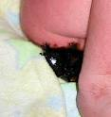
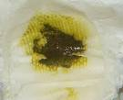
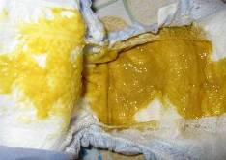
Knowing how much your baby is getting
Notes:
What goes in will come out! The contents of your babies nappy is an important signal that your baby is feeding well.
Your baby should pass urine and their first black (meconium) poo in the first 24 hours after birth. If you don't think they have had a wet or dirty nappy please contact your midwife for advice. Remember the first wet nappy is likely to feel just damp as is a small volume. Nature has cleverly designed colostrum to be high energy small volume feeds this gives your baby everything they need without overloading their kidneys while they get rid of extra fluid from being inside for 9 months. The number of wet nappies will slowly increase every day until they have 6 heavy wet nappies a day at day 5 onwards . To feel how heavy a nappy on day 5 should be add 3 tablespoons of water to a dry nappy.
Babies will lose weight in the first few days , remember when they were weighed at birth their bowels had meconium in and they were carrying extra fluid from being inside.
Typically in Harrogate your baby will be weighed on day 5 in other areas it may be day 3, and your baby may have lost around 7-8% of their birth weight.
However the best way to know how your baby is doing is to look at their poo which changes as they get more milk – expect one poo a day till day 2-3 then your baby should have at least 2 poos a day, soft, yellow and at least £2 coin size – if your baby doesn’t poo one day – TELL YOUR MIDWIFE .
You will also have an in-depth discussion about feeding before leaving hospital and again with your community midwife – there is a feeding checklist in your notes you can look at to check for yourself.

Slide 14
Normal feeding patterns
Notes:
How often do we expect your baby to feed ?
First 24 hours – 3-4 feeds or more. Nature designs that our babies may take long periods of rest after birth, your baby is born with special fat reserves they may use for energy at this time. Try and get some rest to, although often the elation and wonder of having become parents may mean you are full of adrenaline and find it hard to sleep!
Second 24 hours – often 20 feeds or more !!
As baby wakens up after birth, typically babies on Day 2 will feed all night and this is normal – the more your baby feeds the better, this is telling your body to bring in your mature milk
Try not to count the hours you have gone without sleep perhaps from the early stages of birthing, this can be several nights ! – dwelling on these hours lost will not bring them back or help us, ‘let it go’ (imagine the song from Frozen!). Instead, work as a team to support each other and rest when you are able to.
From day 2 onwards your baby needs at least 8 feeds in 24 hours.
We talk about demand feeding (this was originally from a World Health Organisation document so is French – means ‘ask’ - unlike in the UK where it is linked with being demanding). This is allowing baby to give us the signs that they want to feed, not feeding at set times. As you spend time with your baby, you will observe their hunger cues (rooting or searching for the breast, hand to mouth) and respond to them by offering the breast. Responsive feeding is a relationship between you and your baby responding to each others needs, you may want a sit down and rest and feeding gives you a relaxing feeling. Offering the breast can also help to soothe and settle your baby, it is not possible to overfeed a breastfed baby. You can also choose to offer your baby the breast at times to suit you, perhaps when your breasts are feeling full to reduce discomfort or to suit with perhaps needing to get out somewhere and it being convenient for you to feed your baby first.

Slide 15
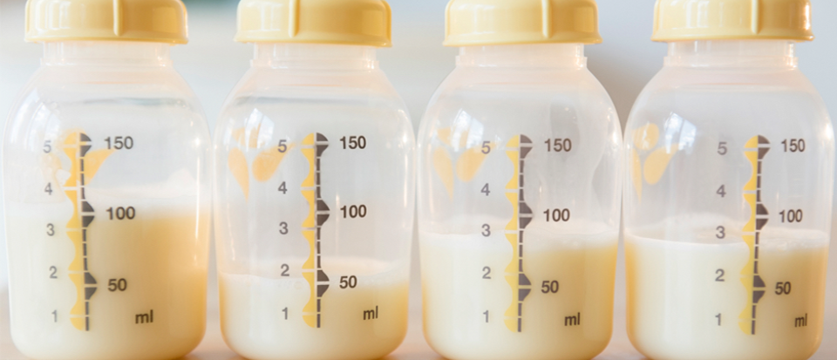
How much milk
Notes:
The amount of milk you produce is dependant on how much your baby or babies feed, the more feeds the more milk you will make.
Your baby switches on the cells in your breasts in the first couple of weeks, avoiding using formula or dummies will mean your baby is able switch on lots of cells so they have enough milk for months to come
In the first 2-3 weeks (approximately) most babies have switched on the cells needed and most mothers will be producing around 800-1000mls a day. Your baby will then adjust your volumes feed by feed and day by day. Only babies know how much and what type of milk they want.
Take your cues from your baby, and they will let you know.
Offer one breast then when your baby comes off themselves, offer the other side. Sometimes they will want a big feed and sometimes just a drink and sometimes they just want to comfort feed (which is amazing for brain development). Think how we choose to eat, how often and how sometimes a snack will do, other times we want a 3 course dinner, your baby is the same.
Our milk is unique to our babies needs, changing to meet their development and growth.

Slide 16
Problems
Mastitis
Too much milk
Thrush
Sore
nipples
Not enough
milk
Engorgement
Notes:
You may have a baby that after birth just seems to get the hang of what to do straight away, feeds with no issues, but some mothers may have challenges or problems with breastfeeding.
Typically women feed their babies for a long time are not the women who haven't faced challenges or problems, but have had resilience and found support in overcoming these.
Particularly sore nipples in the early days – this isn't about getting used to feeding it is because your baby is not quite on correctly – it takes time for you and your baby to work this out together, please ask for help. Creams won’t make it better, they may soothe, but always look at the underlying issue of why you may have become sore- problems with positioning and attachment are the commonest cause.
Engorgement and mastitis are also often due to not quite being attached properly
If you have red patches or feel extremely full – take the milk off as quickly as possible and then get some support – if you are unwell you need to see your GP.
Undersupply is not common, perhaps an historical issue when we did not understand the need to feed babies responsively but fed at set times.

Slide 17
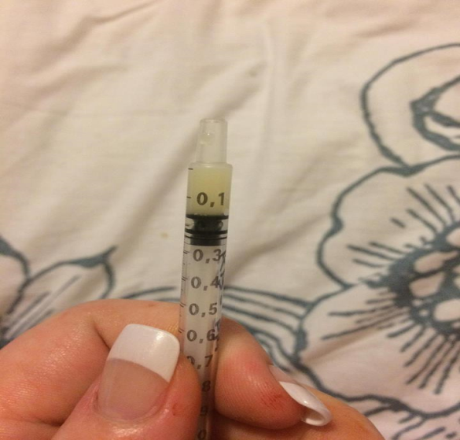
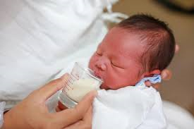
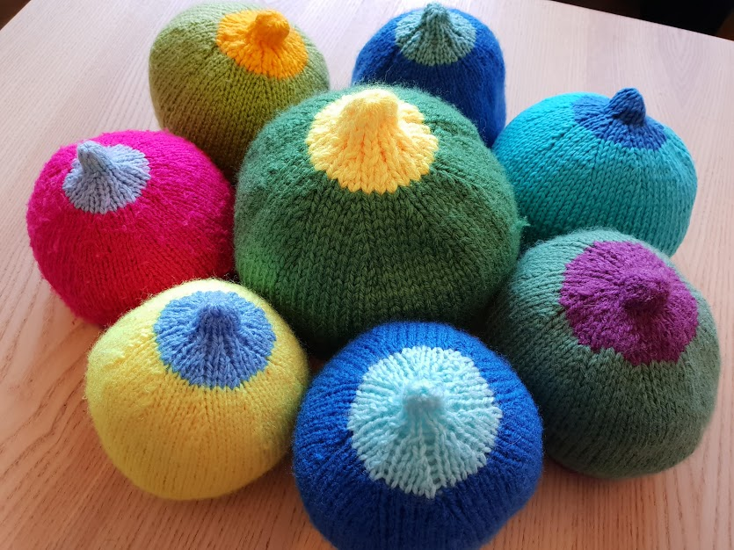
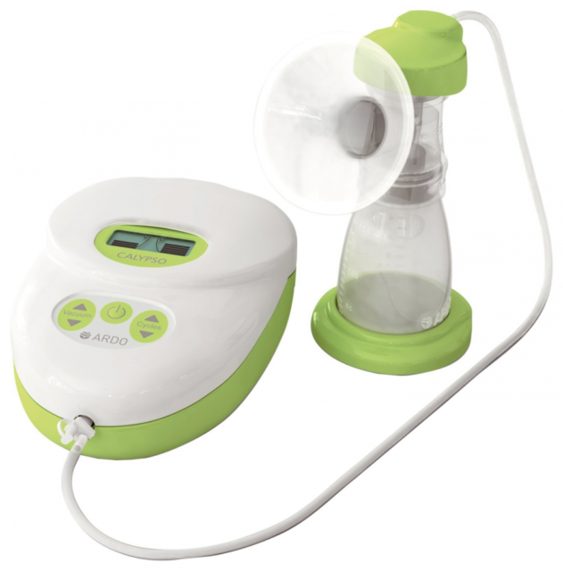
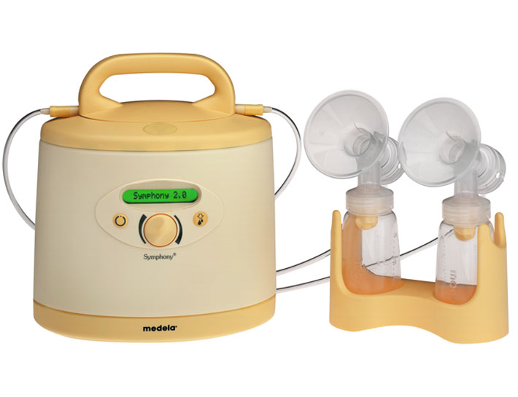
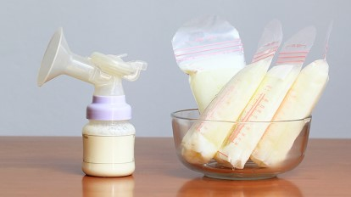
Expressing
Notes:
There may be many reasons why you choose to express your milk, however if you can, it is best to allow breastfeeding to get established first and wait until you and your baby feel confident with breastfeeding before expressing. This allows your baby time to establish your milk supply according to his or her needs. We would also suggest you avoid the use of formula in the early weeks for the same reason. Once your milk supply is established then the possibilities are endless
We also suggest you avoid the use of teats (and dummies) until breastfeeding is more established as we know some babies struggle with attachment following use. If you do eventually want to use bottles as well as breastfeed then we suggest you introduce a teat before your baby is 6 weeks old (NCT research)
If you are having problems and are advised to express then we have pumps in the hospital (yellow pump above) for your use and we would use cups to give your milk, we can also show you how to cup feed. In the first couple of days we suggest use of a syringe to give the small volumes of colostrum (again we will show you how to do this)
If you need a pump for home use you can borrow one for 3 weeks (green pumps above) from the postnatal ward - we ask for a £15 contribution so these pumps can be replaced when they get old
When to express:
You can express after breastfeeds – it may take a day or so for your body to make more milk (your baby does this naturally as they grow – they feed really frequently for one or two days and then magically you produce more milk)
Or some women overproduce in the morning so sometimes its easy to take milk off then, or you can try anytime – you will find the best time for you
Breastmilk can be stored for 5 days in the main body of your fridge, bought to room temperature when ready to use by standing in warm water to take the chill off. It may be kept for 6months in freezer, thawed in the fridge then again brought to room temperature. Never use a microwave to warm milk as this can cause heat spots in the milk that can burn your baby.

Slide 18
Coping strategies
Preparing before
Feeding cues
Nappy changes
Settling / comforting
Sleeping together
Look after each other
Notes:
This presentation may have given you an insight into some challenges or problems you may encounter as you become new parents and establish breastfeeding.
Consider and discuss with your partner and family how you may face and overcome potential challenges and how you may take time before your baby is born to prepare for these, e.g.., preparing nutritious meals that can be frozen and used after birth, having people to support you physically and emotionally, considering what household jobs may be left or delegated to others.
It is also worth having a discussion with each other, family and friends on the emotional help you would like them to offer. All too often mothers and partners are overwhelmed with advice, particularly when something is not going quite to plan. We also commonly hear that when breastfeeding is causing a challenge everyone wants to step in and alleviate what they feel is the issue and advise formula feeding. It can be particularly hard to watch your partner struggling – however we know that 80% of mothers that give up breastfeeding do so before they wanted to and they then often live with this regret. We all need to openly talk about the challenges were going through without the added pressure that you will be told to give up something you hoped and planned to do
A great tip is to get everyone to simply ask “How can I help you?”
Being surrounded by positivity and reassurance that you are doing an amazing job, being provided with drinks, snacks and meals, and given the opportunity for others to settle your baby between feeds while you rest will get you through.
Everything always seems a lot worse when you are tired – Please ask us for help
Keeping your baby close helps you and your baby to learn how to communicate with each other and to respond to cues quicker. Bed sharing safely (see Class 3 or Baby Basics for evidence based advice) keeps your baby close and helps you with this.
Overnight do not worry about changing babies nappy, if your baby settles after a feed and it is not seeping out the sides then leave it. Breastmilk poos are very different to those of a baby once weaning at 6 months and generally aren't smelly- you wouldn't wake your 2 year old child in the night just to change a nappy.

Slide 19
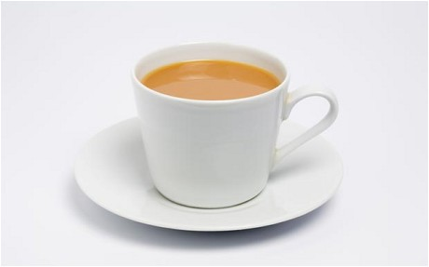
Support
80% of women stop breastfeeding before they want to
Partners, parents and friends strongly influence whether or not a mother continues to breastfeed
Help is available
How can
I help ?
Notes:
We have support groups in Ripon, Knaresborough and Harrogate
Leeds, Bradford and York all have support groups too.
Some of these will now be virtual – please ask your health professional
All our midwives are fully trained however if you have more complex issues you will be referred to the infant feeding specialist Jo Orgles and we will shortly have a virtual specialist clinic running too
Recap
We have all said ‘I can’t do this anymore’
Be ready- discuss your coping strategies before baby arrives, this helps you then to stick to the plan you have made for feeding your baby.
Partners, family and friends will feel protective of you – and may want to run to the local garage to get some formula – but this isn't helpful in the long term and often leaves women with regrets.
Encourage people to ask “how can I help ?” rather than giving you advice (everyone will have their own opinions), the answer may be as simple as time out / or a cup of tea / or a hug .
And remember we can help too. If you still feel breastfeeding is not working for you – come and see us and we will help you make a long term plan that your happy with.

Slide 20
We hope that you have found this of help.

