Slide 1


Birth & Beyond
Meeting Your Baby and the Early Days

Slide 2
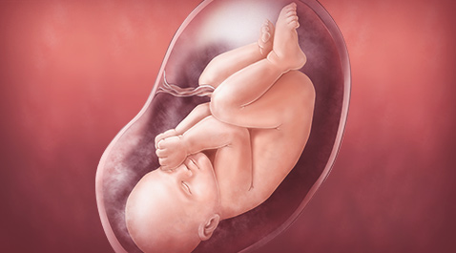
Getting to Know Our Baby
What do you think it is like for your baby being carried inside your womb?
Notes:
In the days and weeks after birth, as parents you get to know and understand your baby, and his or her needs and preferences. As you spend time with your baby you will get better at reading their needs and at interpreting their cries, smiles and body language. At the same time your baby gradually changes too, learning and developing in response to the world and the people around them. Providing consistent and sensitive care at this time is important in order to help babies to communicate and to feel secure that their needs are being met.
What do you think your baby is experiencing and feeling as your are carrying them now?
(Suggestions: warm, safe, secure, comfortable, uncomfortable as they get bigger, snug, muffled noises, mum’s heart beat, dark, constant food supply).
As your baby is born, their environment changes significantly, birth is the biggest life change we ever go through as individuals. Now can you imagine how baby feels?
(Suggestions : cold, exposed, bright, loud noises, lots of room/space, can’t hear mum’s heart beat, feel hunger).
You already know your baby, you have felt them move, likely seen them on scan, talked to your baby, perhaps even read a story or sung to them. Birth is the physical part of the process of seeing them and holding them. As parents you already have a lot of the skills for parenting, by following your instincts. By considering and understanding what your baby has felt or experienced in the womb, this can help us begin to think how we can help our baby feel safe and secure in their new environment, perhaps by replicating their environment inside the womb.

Slide 3
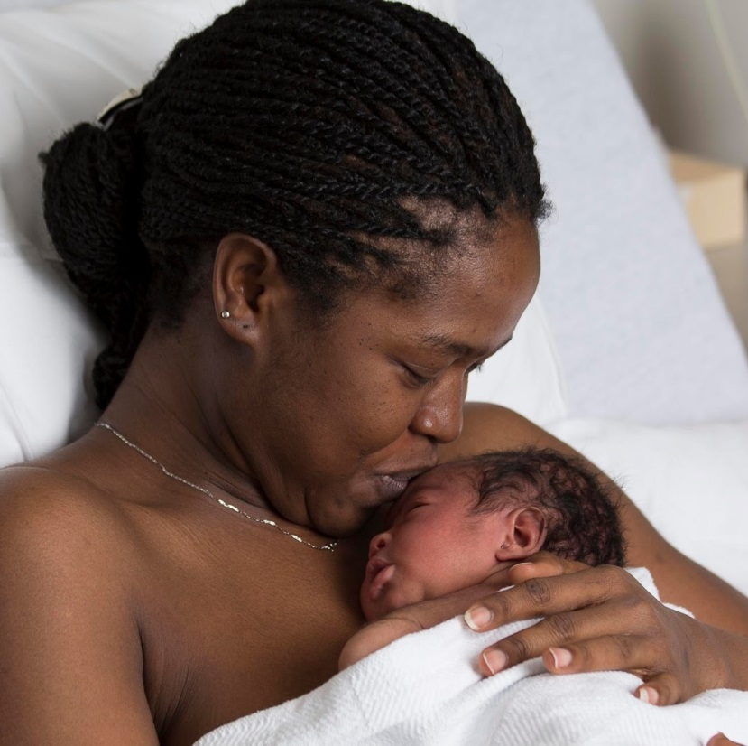
Calming & Soothing Skin to Skin
Benefits of Skin to Skin:
Significantly reduces levels of stress hormones & reduces crying
Helps to regulate your baby’s heart rate, breathing & temperature
Helps to stabilise your baby’s blood glucose levels
Bonding & Attachment –stimulates the release of oxytocin
Encourages mothers to get to know their baby; exploring their features close up
Helps to initiate breastfeeding.
Feel good hormones for parents too!
Skin to skin may be used at any time to calm and soothe your baby after birth
Notes:
As baby is born, starting skin to skin is a great way of replicating how the baby felt in the womb.
Un-interrupted skin to skin with Mum is advised for every baby, however you have chosen to feed your baby.
Skin to skin can be used at any time, by either parent to help your baby feel safe and calm and to soothe them.

Slide 4

Responsive Parenting
Babies are born with the ability to communicate, they cannot distinguish between ‘big’ problems and ‘small’ problems; they need an adult to come along and solve their problems
By noticing and interpreting your baby’s cues, and responding promptly, your baby learns that you will respond and so your baby will develop confidence that their world is safe and secure
With practice, your baby will get better at giving cues and you will get better at responding to them.
These babies become more resilient, are better able to manage their own emotions, and are more confident children- this effect continues into adulthood and research shows these adults have better emotional health
Notes:
Babies are born completely defenceless and rely upon an adult to protect them and care for them, they are born with the ability to communicate with us.
As we spend time with our baby as parents, we learn to read their cues, e.g., rooting as a sign of wanting to feed. At first it can be difficult to read their cues, but keeping your baby close and watching them helps us learn. Newborn babies are still learning to control their bodies, with practice, your baby will get better at giving cues and you will get better at responding to them.
As you respond to your baby’s cues, you will both learn you can communicate with each other, and by doing so your baby will develop confidence that their world is safe and secure.

Slide 5
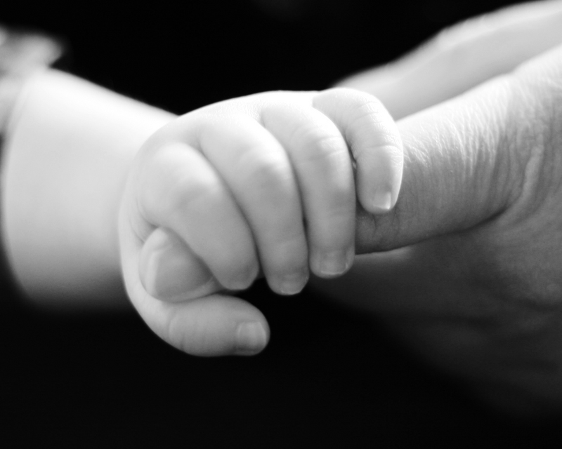
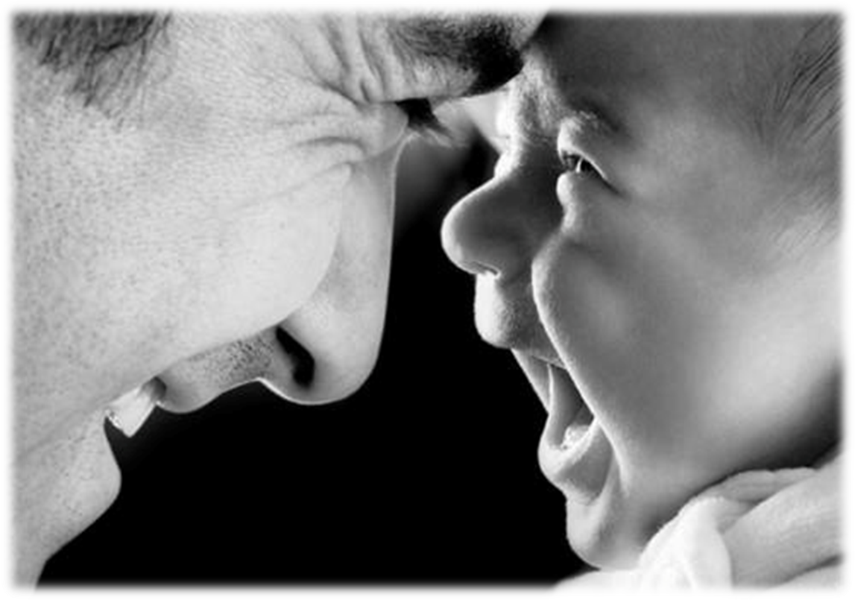
Brain Development – Making Loving Connections
Parenting is one of the most powerful influences on both a child’s well being and future outcomes.
Notes:
The first 2 years of a child’s life are an especially critical period for brain development. The brain develops rapidly and is at its most receptive to new information as well as positive and negative influences.
The more our baby is responded to and stimulated e.g. by meeting their basic needs of feeding, comfort, caring, playing, talking to etc. the more positive this development will be.
New connections are being constantly formed from new experiences; sounds, sights, touch, smells and tastes as they experience the world around them. Babies love faces, it is thought that they see at a distance of around 20-30cm away, an can see the shape and shadow of our faces. They begin to associate with facial expressions and the sounds we make, e.g., smiling and laughing with happiness and excitement. Holding our baby close and making eye contact is really important for their brain development.

Slide 6
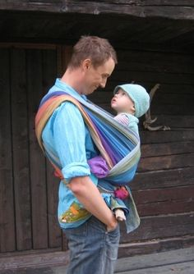
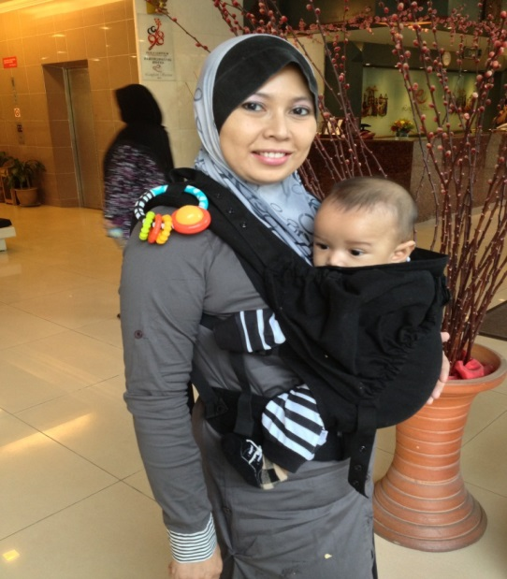
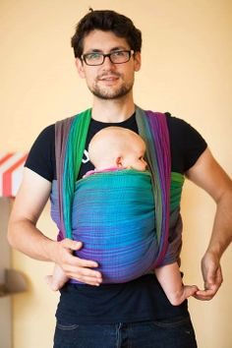

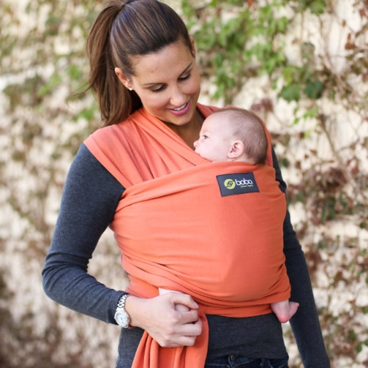
Keeping Your Baby Close
By keeping your baby close you can pick up on their cues and respond more quickly
Local Sling libraries are available for support and safety advice re baby wearing.
T-tight
I-in view at all times
C-close enough to kiss
K-keep chin off the chest
S-supported back.
Notes:
The most important thing for your baby to feel safe and secure is to be kept close. It is an old wives’ tale that you can build a rod for your own back if you carry your baby around.
You cannot spoil a new-born, nor can you cuddle them too much!
Slings
Slings and baby-carriers are useful for holding a baby hands-free, however they are not always used safely. Although there is no reliable evidence that slings are directly associated with SIDS. However, the risk appears to be greatest when a baby’s airway is obstructed either by their chin resting on their chest or their mouth and nose being covered by a parent’s skin or clothing.
The safest baby carrier to use will keep the infant firmly in an upright position where a parent can always see their baby’s face, and ensure their airways are free. Complete guidance is available by visiting The Royal Society for the Prevention of Accidents.

Slide 7
How might I feel when my baby cry's?
Remember crying is a normal part of our baby's’ development, but how might it make us feel?
Baby may cry for no obvious reason and this can be upsetting and frustrating when as new parents we may feel at a loss to know what to do
Who might be able to offer help? Considering who I may call for support.
Notes:
Have a discussion antenatal with your partner as to how you may both feel hearing your baby cry.

Slide 8

What might this baby be trying to tell us?
I’m too cold or hot
I’m feeling lonely
My nappy needs changing
I want a cuddle
I need winding
I’m frightened
I’m feeling fed up
I just want to be near you
I’m hungry
Notes:
As baby cries, pick them up, hold them close, sometimes simply doing this has reassured them that they are safe and secure to soothes them.
Breastfeeding has a multitude of uses, perhaps your baby is not hungry but being at the breast offers them reassurance and comfort.
It can be confusing as new parents trying to understand what our baby is trying to communicate with us as to their needs, and we may not get it right all of the time. By simply responding to your baby and interacting with them, we are encouraging positive, loving connections to be made, helping our baby to feel safe and secure.

Slide 9
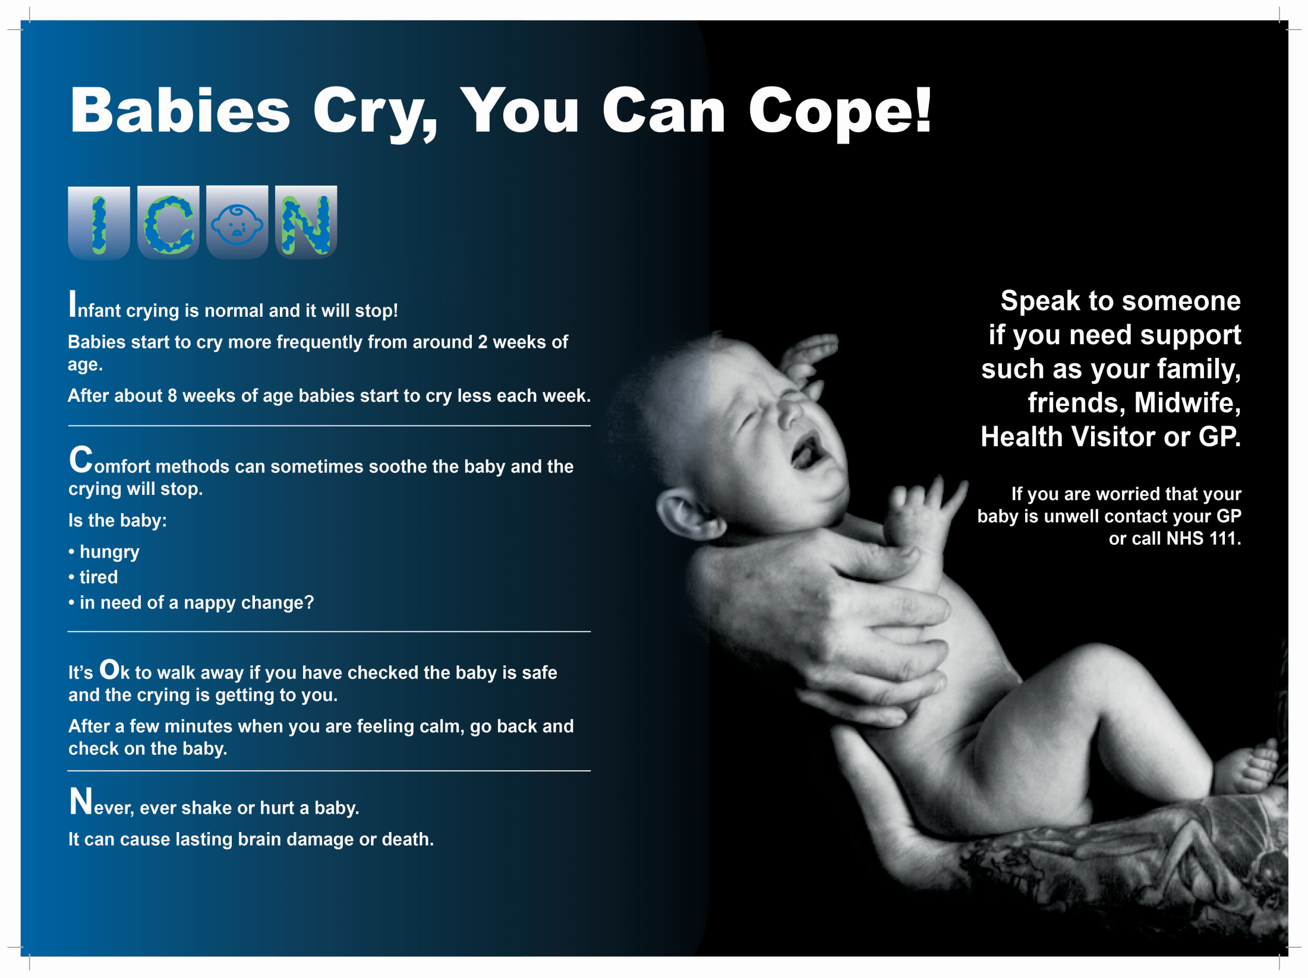
ICON
Notes:
In the antenatal period, your midwife will introduce you to ICON.
In classes we have always talked about coping with crying, ICON is the official recognition of how to do so. As parents it helps us to understand that our baby crying is a normal part of their development but also helps us to consider how we cope with this and to consider and put plans in place for when we feel we are not coping.
To put baby down safely in a Moses basket or their cot, to step away for a few moments if we feel that we are on the verge of not coping, to take some deep breaths, call for support, then to go back when we feel calm, pick our baby up and hold them close. Think now about who will be there to support you and who you could call if you need support to cope.
As per the slide, if you feel your baby may be unwell, seek medical opinion.
ICON will be revisited with you after your baby's birth and once you have taken baby home.

Slide 10
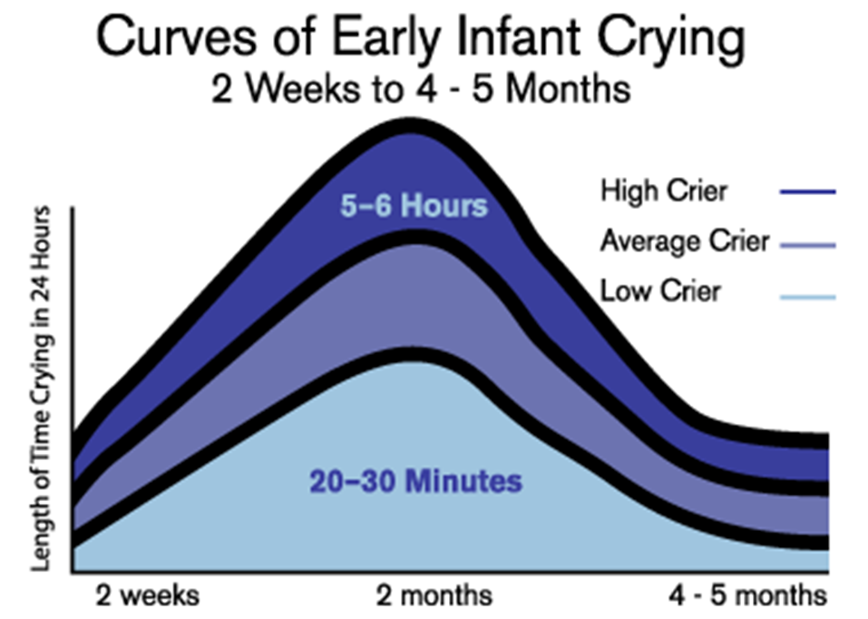
Coping with crying- ICON
Notes:
This graph helps us understand that each baby is an individual and how every baby may cry for differing amounts of time in a 24 hour period.
As we respond to our baby and both learn we can communicate with each other, they feel increased safety and security in the world around them and will settle.

Slide 11
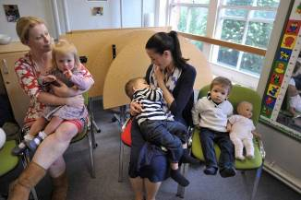
Available Support after birth
Family and friends
Community Midwife (first visit for support the day after home birth or the first day home from hospital)
Health Visitors
Parent Support Advisors (Children's Centres)
Your GP/ Out of hours GP
Breast Feeding Support Groups and Parent and Baby groups at Children’s Centres
Notes:
Your midwife will be informed of your discharge from hospital and will be there to provide support visits or phone support as needed.
You will be given a contact number so that you know how to contact a midwife for your area should you need advice between contact with your midwife.

Slide 12
Looking After Your Baby
Notes:
The following slides will give you some advice of aspects of baby care.

Slide 13
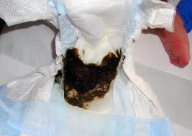
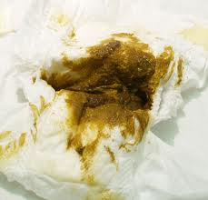
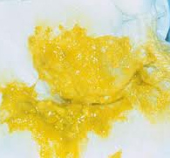
Nappy Changing
Day 1-2
Meconium
Day 2-3 Changing Stool
Day 4-5 Onwards
How do I know my baby is getting enough milk?
From day 5 onwards your baby should have at least 6 wet nappies every 24 hours
Pass at least 2 yellow stools every 24 hours
Notes:
What goes in , comes out! The contents of you baby’s’ nappy are a great way of reassuring us how well our baby is feeding.
Baby should have their first poo and pass urine within 24 hours of birth, if you don’t think they have and are at home, you need to let us know.
Their first poo is called meconium, is black in colour and a tar like in consistency.
As the baby takes in milk , the meconium loses its tar like consistency and by day 2-3 should be green/brown and runnier, defiantly easy to clean off.
By day 4-5 baby's poo should be yellow in colour (think korma, piccalilli or English mustard!) soft in consistency (breastfed babies may have loose stools) and pass at least two poos a day, around £2 coin size).
If you are concerned baby is not having this change in colour or not passing two poos a day then speak to a midwife for advice.
Mention the ‘yellow line’ that is on some nappies which may help parents identify the baby has passed urine when the nappy is heavily soiled.
NICE (National Institute for Clinical Excellence) does not advise the use of wipes or cleaning agents, your baby's skin at birth is thin and can be easily damaged, baby's skin matures and develops its own protective barrier. Cotton wool and warm water alone is sufficient (warm tap water) for a period of at least 4 weeks.

Slide 14
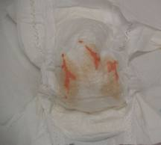
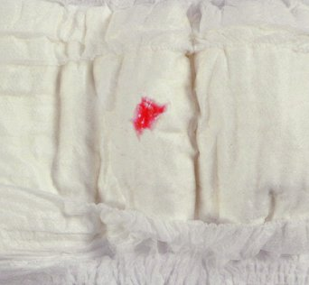
Nappy Changing
Urates
Pseudo menstruation
Have a go at Nappy Changing!
Notes:
As per the previous slide, baby should have its first wee in the first 24 hours, this may be hard to notice as is likely a small volume and nappies can be very absorbent. If you are unsure then placing some cotton wool in the nappy can hold the urine and make it easier to tell. yourself). The baby may pass some urates in the first few days. These salts are orangey/pink in colour and are completely harmless.
In the first 48 hours baby may only have 2-3 wet nappies, then wet nappies will be more frequent and heavier (you make wish to try putting 3 tablespoons of water into a nappy to experience how you can feel the heaviness for yourself). Urates: sometimes known as ‘brick dust’, they are orangey/pink in colour and are completely harmless. They are just salts in the urine and are usually passed in the early days.
In baby girls, they may have some false or pseudo menstruation is harmless. It is a very light bleed from the vagina and comes from the effects of your own hormones on her system, and it soon stops.
We do not advocate any particular brand, many brands have a ‘yellow line’ on which may help parents identify the baby has passed urine when the nappy is heavily soiled. There is no need to use any creams, a clean dry nappy is best for baby, some air to that area by letting baby lay on a towel as you change and play with them. Many creams are heavily perfumed and astringent and do not protect the skin. If baby does develop some nappy rash and the skin gets sore, seek advice. You may be advised to use a little barrier cream, just on the area that is sore, to protect the sore skin from damp while the new layer forms.
You are likely to change between 6-12 nappies in a 24 hour period, it is amazing how quickly you become confident at this.

Slide 15
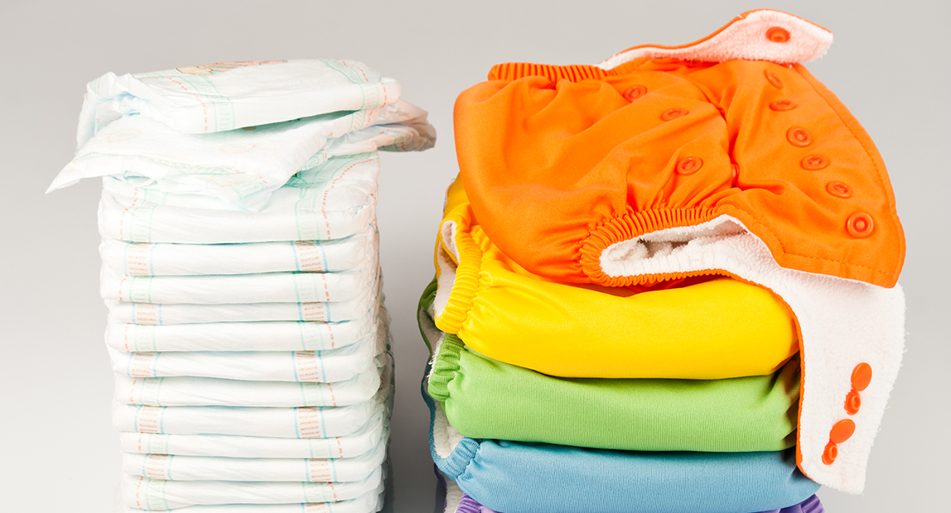
Cloth Nappies or Disposable Nappies?
The choice is yours! There are local ‘Cloth Nappy Libraries’ available for advice and information. Many Nappy Libraries have starter kits available for loan.
Notes:
You may wish to consider using cloth nappies. There is little evidence as to which option may be ‘best’ for the baby, it may be that they are better for the environment.

Slide 16
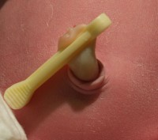
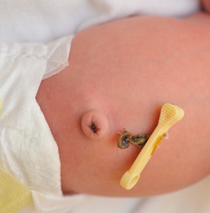
Cord Care
Cord Care
Clean around the cord with water & cotton wool
Keep clean & dry
Fold the top of the nappy down
Antiseptics should NOT be used routinely
Usually falls off between 5-15 days.
Notes:
Folding the top of the nappy over so that the cord can lie outside of the nappy and not be involved in its contents. The cord has no nerve endings so may be moved gently out of the way.
As the cord dries out it may become a little sticky, if oozing then wipe gently with damp cotton wool and dry. It separates by all the natural bacteria on the skin around the cord being involved in the separation process, cleaning too regularly may remove this natural flora.

Slide 17
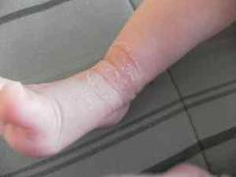
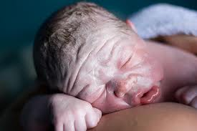
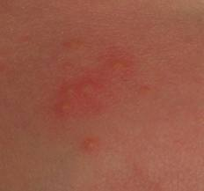
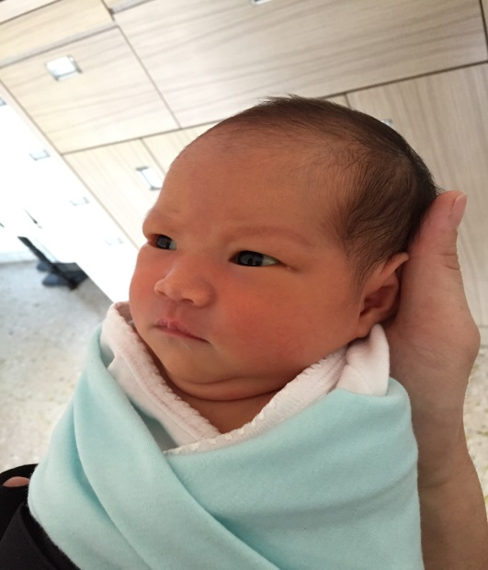
Skin Care
Common skin appearances in the new-born:
Dry Skin
Vernix
Erythema Toxicum
Jaundice
Notes:
Dry Skin:
Quite often if your baby is overdue, their skin may be dry and cracked. This is because all the protective vernix has been absorbed in the womb. Do not use any creams or lotions as they may do more harm than good. The top layer of your baby's skin will peel off over the next few days, leaving perfect skin underneath.
Vernix (the white sticky substance that covers your baby's skin in the womb) should always be left to absorb naturally. This is a natural moisturiser and protects against infection in the first few days. If there are areas with a thick build up, where it may take a long time to wear away or absorb, your midwife may help some of the thickness come away without removing it so much to damage the underlying skin.
Erythema Toxicum:
Half of all new-borns develop a blotchy red skin reaction called erythema toxicum, usually at two or three days old.
It's a normal newborn rash that won't bother your baby and clears after a few days.
Jaundice- many babies have a degree of jaundice that occurs after the first 24 hours, if your baby is feeding well it will clear after a few days or longer, if your baby is sleepy or not feeding well, offer more skin to skin and regular feeds, your midwife may advise you to express and offer your baby breastmilk if they are not feeding well. Some babies may need some additional help in resolving the jaundice using phototherapy alongside regular feeding.

Slide 18

Bathing
Plain water, for the first month, bathing is for enjoyment too for both baby and parents, keep talking to your baby to help them feel more safe and secure.
Notes:
Bathing a couple of times a week is enough for the first month to allow your baby's skin to mature.
The midwife will show you how to clean the baby's eyes and face with warm water, you can do this morning and evening….bottoms will be cleaned much more regularly as previously discussed!
Bathing is a great time to have fun with your baby, lots of mutual gaze, smiling and talking to your baby will help them feel more safe and secure and enjoy the experience. You may also wish to co bath with your baby, enjoy skin to skin in the warmth of the water. Your baby may feel more at ease bathing in this way, a lovely opportunity for partners to enjoy skin to skin with baby. Be mindful the temperature of the water is not too hot for baby (37 degrees Celsius).
NICE (National Institute for Clinical Excellence) does not advise the use of wipes or cleaning agents, your baby's skin at birth is thin and can be easily damaged, baby's skin matures and develops its own protective barrier. Cotton wool and warm water alone is sufficient (warm tap water) for a period of at least 4 weeks.

Slide 19

Feeding Our Baby
Does breastfeeding really matter?
Breastfeeding is not just about nutrition for your baby, it has so many other benefits!
Notes:
We also have an Infant Feeding workshop (as a separate class) that we advise you to look at which gives much more comprehensive information on infant feeding and the options and choices you may make.

Slide 20
What is Breastmilk made up of?
Enzymes
To help aid digestion
Antibodies
To fight infection
Hormones
E.g. insulin, thyroxine, growth stimulating hormone
Viral fragments
To help activate your baby’s immune system
White cells
To destroy bacteria
Oligosaccharides
Sugars that stimulate your baby to open his/her bowels
Anti-inflammatory Properties
Notes:
Antibodies
To fight infection
Hormones
E.g. insulin, thyroxine, growth stimulating hormone
Viral fragments
To help activate your baby’s immune system
White cells
To destroy bacteria
Oligosaccharides
Sugars that stimulate your baby to open his/her bowels
Anti-inflammatory Properties
To help reduce inflammation

Slide 21

Benefits of Breastfeeding
For Baby:
Reduces the risk of:
  Diarrhoea & vomiting resulting in hospital admission
  Chest infections resulting in hospital admission
  Ear infections
  Developing eczema
  Obesity
  Diabetes
  Sudden Infant Death

Slide 22
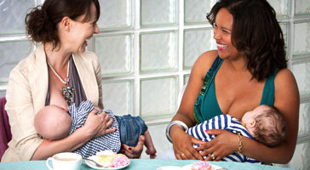
Benefits of Breastfeeding
For mothers:
Lowers the risk of mum getting breast cancer
May reduce your risk of getting ovarian cancer
Fantastic for bonding with baby
It saves money!

Slide 23

Postnatal Washing Line
Notes:
This part of class we would explore postnatal advice for Mum, baby and the family.
Vaginal blood loss after birth (lochia)
However you birth your baby you will experience some vaginal blood loss afterwards. It is important to use sanitary towels only (tampons increase risk of infection), the blood is coming from the area your placenta had been, as it comes away it leaves any area that needs to heal. Blood loss that is soaking through a sanitary pad in 30-60 minutes, making you feel dizzy or sweaty or making your heart race is too much for you and you should seek help immediately. The blood loss lasts on average 2-3 weeks, starts as fresh red then becomes lighter in colour and the amount reduces as the days go on. If you breastfeed you may feel some contracting in your lower abdomen and the blood loss may increase a little during and after the feed as your body reasons to the baby feeding. Cheap, thick sanitary pads work best for absorbing the blood loss in the first few days.
Big pants!
After birthing your baby you will want underwear suitable for holding the pads in place and are comfy to wear. If you have had a caesarean you want pants generous enough to come well above your bikini line as this is where the stitches would be. Generally disposable pants seem to have the same length of elastic in them be a size 8 0r 20 so old or cheap pants you don’t mind throwing away work best.
Stitches
Any stitches you have after birth are dissolvable. If you have stitches in your perineum (the area between the vagina and your back passage) it is important to keep the area clean. Change your sanitary pad often and clean the area in a shower twice a day. Let the area dry before putting your underwear back on. Many ladies worry about opening their bowels after stitches, keeping well hydrated and a fibre rich diet will keep your stools soft and easy to pass, try to avoid constipation as this may make it more uncomfortable to pass your stools.
Pelvic floor exercise are really important to help the muscles that have been repaired to strengthen again (see later slide on how to perform these).
Nursing bra and pads
Make sure you are wearing a bra that is soft and comfortable to wear, be sure if your bra is underwired that the wires are not digging into your breast tissue. The breasts can leak between the times your baby feeds so you may wish to use a pad. If you are leaking a lot of milk you can buty breast ‘shells’ that fit inside your bra to collect the milk so that it is not wasted
Hearing screening
Your baby will be offered a hearing screen while you are in the hospital, our hearing screeners work 7 days a week. The screen is done at your bedside, ideally at a time when your baby is settled. It involves two small ear buds gently applied to baby's ears and soft clicking sounds are made and the test picks up a response that feeds into a microphone into the earpiece. If there is no response at this stage, you will be offered an additional screen. Should there not be a response, your baby will be referred to Audiology for further investigation, this does not necessarily mean your baby has a hearing loss. The test usually takes 5 minutes.
NIPE (Non Invasive Paediatric Examination)
At birth the midwife will check your baby head to toe and let you know if we had any concerns. The NIPE check is performed in the first 72 hours of birth either by a midwife you has undertaken training to do so or a paediatrician. The check involves looking into your baby's eyes with an ophthalmoscope, taking measurements of your baby's head circumference and check your baby's hips and whether they need any specific vaccination (e.g., an early BCG for baby's born to parents of ethnicity that may increase risk for TB).
Purple and red books
You will receive both of these once your baby is born.
Purple books are the postnatal version of the green booklet you had in pregnancy for your antenatal care. There is a darker one for Mum, a lighter coloured one for baby. Please take time to have a read through both as they have lots of helpful information and advice in them. As you have you postnatal care the midwife will document in these. At the point of discharge, the booklets are returned to the hospital and filed in your hospital notes.
The Red Book documents details of your baby's birth, administration of Vitamin K, the hearing screen and NIPE check. This remains your baby's health record to the age of 5 and all their developmental checks and vaccinations will be recorded here. Remember to keep it safe and take it home with you on discharge.
Friends and Family Test
This will be given to you at the point of discharge and asks you to give us some feedback of your care, please tell is if there is something from your experience that could have been improved on, and equally please tell us what has gone well!
Blood spot screening
This is a test offered to your baby on Day 5 after birth. It can be performed at home or at a drop in clinic, the midwife uses a heel prick device to collect some blood from your baby's foot. This blood is then put onto 4 dot markers on a specialist card and screens for many conditions such as hypothyroidism, cystic fibrosis, sickle cell anaemia and thalassemia and rarer metabolic conditions. Should your baby have a positive screen for any of the conditions we test for, then we can plan lifestyle changes and care that your baby may need. The results may take 1-2 weeks to come back and you will be informed of these results by letter. Should there be a positive screen you would have been contacted by phone. The test can be done while you are holding or feeding the baby.
Body image
Just as it has taken your body time to grow and birth your baby, it takes the body time to return to its pre pregnancy form after birth. As we look at the world around us, perhaps in the media or the glossy magazines, images are portrayed of women looking glamourous, full make up, hair blow dryed….is this reality? Likely not, perhaps more due to a team of makeup artists and stylists helping her..
What is important is to enjoy spending time with your baby, looking after yourself, eating well, resting and enjoying fresh air and exercise. It may take your body as long to return to ‘normal’ as it did to grow your baby.
Registering birth
At the present time in light of COVID 19 the arrangements for registering your baby’s birth has changed to the normal arrangement, please speak to your midwife for advice. It is likely that the usual time frame of 6 weeks for this will be extended.
Sex and contraception
For every women, it is a very individual choice for when you may feel ready to resume intercourse. Discuss how you feel about this with your partner. It is advisable to wait until your lochia (blood loss) has stopped for a few days before resuming intercourse as this is a sign that area where your placenta had been has healed.
Your midwife will discuss your options for contraception with you before you leave hospital and your community midwife will too at home. Having just had a baby or breastfeeding does not offer 100% protection so it is important to consider contraception before resuming intercourse if you are not planning on having another baby straight away. At the point you do consider trying for another baby, remember to take folic acid ideally 3 months pre conceptually.

Slide 24
Notes:
It can be hard to consider Sudden Infant Death Syndrome (SIDS) before your baby has been born, but all the advice that we know helps to reduce the risk is all easy to follow.
Whether you are putting your baby down to sleep in a Moses basket, cot or the pram:
Put your baby down on her back to sleep, never on her front or side
Feet to the foot of the Moises basket or cot- as your baby's feet touch the end they do not have ‘spaces’ to move down into once you have secured their covers at should height
Baby sleeps in the same room as a parent for at least the first six months
The mattress is firm, flat with a waterproof cover – soft beds, bean bags and sagging mattresses are not suitable
Your baby is not overdressed or covered with too much bedding (no more than you would use yourself)
The bedding must not be able to cover the baby’s head
The room is not too hot (16-20°C is ideal)
The room where your baby sleeps is a smoke-free zone.
Cot bumpers are NOT recommended as they can cause overheating which is a risk for SIDS.
Sleeping bags: Although there is no published research comparing their safety to blankets, Infant Sleep Information Source (ISIS) advises a lightweight, well fitting sleeping bag can be used. If you use a sleeping bag, do not use additional sheets or blankets. Use the appropriate TOG value for the season of they year.
Caring for Your Baby at Night, A Guide for Parents. UNICEF (2017).
www.lullabytrust.org.uk (2017)
BASIS (2019)

Slide 25
Notes:
Never sleep on the sofa, or arm chair with your baby:
Do not put yourself in a position where you could doze off with your baby on a sofa or armchair
Alcohol, drugs or smoke:
Do not sleep with your baby when you have been drinking any alcohol or taking drugs that may cause drowsiness (legal e.g., medication or insomnia, some types of pain relief or even a drowsy cough mixture or illegal substances).
Do not sleep with your baby if you or anyone else at home is a smoker.
Avoid letting your baby get too hot:
It is important to make sure that your baby is a comfortable temperature – not too hot or too cold. The chance of SIDS is higher in babies who get too hot.
A room temperature of 16-20°C, with light bedding or a lightweight well-fitting baby sleep bag that is comfortable and safe for sleeping babies. Babies hands and feet are often cooler that the rest of their body so never feel there and wrap them more. Feel the baby centrally at the nape of their neck or their chest/tummy.
A clear cot is a safer cot:
No pillows or duvets;
No cot bumpers;
No soft toys;
No loose bedding;
No products to keep a baby in one sleeping position such as wedges or straps
Swaddling
Some believe swaddling young babies can help them settle to sleep. Whilst we do not advise for or against swaddling, we do urge parents to follow the advice below. If you decide to adopt swaddling, this should be done for each day and night time sleep as part of a regular routine:
use thin materials
do not swaddle above the shoulders
never put a swaddled baby to sleep on their front
do not swaddle too tight
check the baby's temperature to ensure they do not get too hot
www.lullabytrust.org.uk (2017)
Caring for Your Baby at Night, A Guide for Parents. UNICEF (2017).

Slide 26

Do you intend to bed share with your baby?
Whilst most expectant parents will say no, over half of babies born each year will have slept together in an adult bed with one or both parents by three months, whether intended or not (UNICEF 2017)
Keep baby away from pillows
Make sure they cannot fall out of bed or become trapped between mattress & wall
Bedclothes cannot cover baby’s face or head
Do not leave them unattended in the bed
It is not safe to bed-share in the early months if your baby was born very small or preterm
Do not sleep with your baby when you have been drinking any alcohol or taking drugs (legal or illegal) that might make you sleepy
Do not sleep with your baby if you or anyone else in the bed is a smoker
Notes:
Bed sharing with baby- if you follow the principles of doing it safely then the risk of SIDS is no greater. The evidence suggests that it is not bed-sharing per se that is a risk factor, but the circumstances in which it occurs, e.g., consumption of alcohol, parents who smoked, falling asleep on the sofa with baby.
Whether you think you intend to co sleep or not, sometimes the reality is that once baby is born may co sleep when it had been your intention.
Discuss your preferences and then revisit the principles of safe bed sharing once baby is born. It is a good idea to do a mental checklist at the point you may start bed sharing to reassure yourselves you are doing it safely.
UNICEF (2017). HEALTH PROFESSIONALS’ GUIDE TO: “CARING FOR YOUR BABY AT NIGHT”

Slide 27
Mums Day and Partners Day
Consider your individual roles and activities, perhaps your current share in household chores…
How might they shift?
Who will take on what role?
What might the new priorities be?
What can we plan before baby arrives to make this adjustment easier?
Notes:
This part of class we would explore changing relationships within the family as baby is born.
Perhaps when you first arrive home your partner will have some time off work for you to spend as a family and for you to have support.
At the point your partner returns to work, you may both have days that may be long and tiring, but in different ways. Its important to acknowledge this and to continue to communicate and support each other.
Having a baby is likely to have a change on the dynamics in your relationship, perhaps a shift in responsibilities. Explore and discuss these before baby arrives so that you can manage expectations and prepare and plan as best you can.
Consider perhaps getting the freezer stocked with homemade nutritious meals (perhaps that can be eaten easily with a fork in one hand) so that you don’t have to spend time planning and cooking meals in that first few weeks.

Slide 28

Baby Blues
Up to 80% of new mothers go through the ‘baby blues’
Usually occurs in the first three or four days
New mums can become very tearful
It may be caused by hormone changes, tiredness and possible discomfort after birth
It usually passes after a few days.
Notes:
Lots of love, support and reassurance that this is a normal process and is likely to pass, taking rest when you are able between feeds, go for a walk and get some fresh air.

Slide 29

Self-help advice for postnatal emotional wellbeing:
Accept help from friends and family, its OK to take a break
Try and rest when the baby is sleeping
Spend as much time as you like cuddling and holding your baby – this has a soothing and calming effect
Try and eat a healthy diet and drink plenty of water
Light exercise, or just being out in fresh air can enhance your mood
Socialise at local baby groups, or children’s centres to meet other parents and build a support network.

Slide 30
More than the baby blues?...
“ I should be happy……but I’m not”
Postnatal depression can affect as many as 1 in 7 new mums and 1 in 10 new partners
Signs and symptoms may include
  Feeling low, overly tired, tearful or irritable
  Anxiety, worry and tension
  Difficulty sleeping even when your baby sleeps well
  Difficulty in concentrating
  Thoughts of not being a good enough parent
  difficult or unexpected feelings towards your baby
  feelings of hopelessness
  feeling unable to cope or enjoy anything

Slide 31
Help and support is there for you
The first step is recognising it and then asking for help
Self help- getting some exercise, time out to enjoy doing something you enjoy, support groups
Talking therapies- talking to your partner, family and friends, speaking to your midwife or health visitor and your GP
Medication – safe to take on the advice of your doctor, safe with breastfeeding

Slide 32
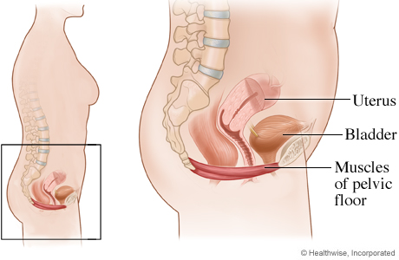
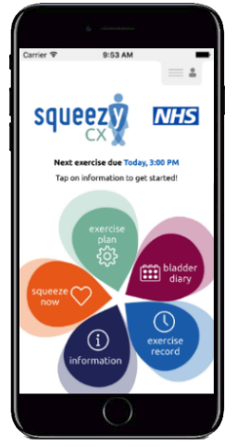
The Importance of Pelvic Floor Exercises!
Remember!
10 long squeezes (10 seconds)
10 short squeezes (1 second)
3 TIMES A DAY!
ACTIVITY
For a great reminder - Download the NHS Squeezy app today!
Notes:
The pelvic floor is the ‘hammock’ of muscles that supports the abdominal and pelvic organs, during pregnancy they have additional weight to support. It is really important that these muscles are exercised in pregnancy and after baby is born. If you lose tone in the pelvic floor it may lead to issues with urinary and faecal incontinence and prolapse later in life.
The additional weight that you are carrying as you near your due date in pregnancy:
Uterus 1.5kg - it has increased in size and weight to accommodate baby
Baby 2.5-3kg – average baby weight at birth is 3.5kg (7 ½ lb)
Amniotic Fluid 1l – continually produced by the amniotic sac to cushion and protect baby
Placenta ½ kg – about the size of a dinner plate and 3cm thick
Breasts ½ to 1 kg – as the breasts enlarge and prepare for milk production
Extra body fluid 2l – all parts of the body retain extra water
Extra fat 1kg – in preparation to keep baby well-nourished in utero and and when breast feeding
Extra blood 1l – a mother’s blood volume increases about 40%
Perhaps get a carrier bag or a pillow case, load household items into it and let your partner feel the weight that you are having to carry around the pregnancy.
Generally thinking about the muscles that you use to stop the flow or urine and to stop passing wind, isolate them and do squeezes and longer holds (10 repetitions) a few time times a day. Perhaps link them to everyday activities, feeding baby, cleaning your teeth, making a cup of tea or a meal. Ask your partner to remind you or even better so them with you (pelvic floor health is good for partners too!).
The NHS App Squeezy acts as a good reminder or prompt to perform pelvic floor exercises.

Slide 33
Nearly done!
Remember to access www.hdft.nhs.uk for a range of leaflets with information you may find helpful
Harrogate Maternity Mums and Midwives Facebook group- on line tour video
Your community midwife or Rachel Robson Parent Education Midwife should you need any additional support- hdft.parent.eduaction@nhs.net
Maternity Voice Partnership (MVP)link hdft.mvp@nhs.net – giving feedback on your care to develop our services further

Slide 34

“A baby fills a place in your heart you never knew was empty” - Unknown
We wish you all the best on your exciting journey to parenthood!
Photo Credit: www.pregnancyandbaby.com
Notes:
In these uncertain times, babies will still grow and be born into the world, enjoy every moment, they grow and change so quickly before our eyes.

