Slide 1
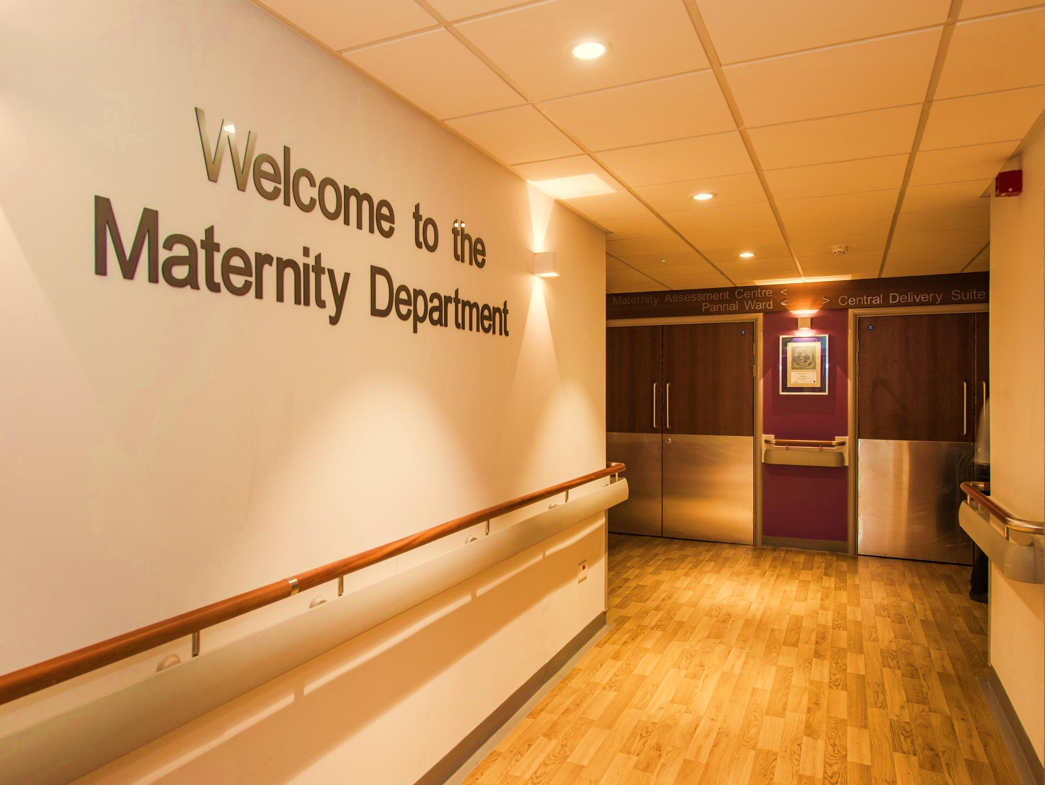
Birth & Beyond
Class Two: Pain Relief & When Nature Needs a Hand

Slide 2
Aims & Objectives
To explore pain relief options available to you at home and whilst in hospital
To discuss how to write a birth preference list
To explain the process of induction of labour
To understand the different ways of monitoring your baby and why we advise them
To discuss instrumental deliveries and caesarean sections
To discuss the role of the birthing partner

Slide 3
Coping mechanisms and keeping calm for birth
Can you remember all the coping mechanisms you can use to keep calm during birth, use both at home and hospital?
Notes:
Perhaps you and your birth partner can test each other to see what you can recall from all the content from Active Birth, before moving onto the next slide.

Slide 4
Warm bath
hydration
REST!!
TENS
snacks
m
deep breathing
paracetamol
massage
Not clock watching
distraction
Self belief
music
Low lighting
Active birth positions
Supportive birth partner
hypnobirthing
Home comforts- dressing gown, soft pillow
Smell- aromatherapy , perfume
Notes:
Some answers

Slide 5
TENS
Paracetamol & Codeine
Relaxation Techniques
What are my pain relief options in hospital?
Massage
Birthing Pool
Epidural
Gas & Air
Diamorphine
Notes:
These are all the options available at birth in hospital.
The only three options that cannot be provided for home birth would be codeine, diamorphine and epidural.

Slide 6
Paracetamol & Codeine Phosphate
What is it? Opioid analgesia
Good for: mild – moderate pain
Dosage: can take 60mg 4-6 hourly, maximum of 4 doses in 24 hours
Most common side effects: nausea, vomiting, constipation
PRESCRIPTION ONLY
Not given postnatally if breastfeeding
Good for: mild – moderate pain
Dosage: can take 1g 4-6 hourly, maximum of 4 doses in 24 hours
Side effects: very rare

Slide 7
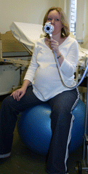
Entonox
What is it? 50% oxygen & 50% nitrous oxide
Advantages:
Self administered
Quick acting
Short Lasting
Helps to focus deep breathing
Takes the edge off contractions
Can be used alongside other analgesia
Doesn’t cross the placenta
May be used at a home birth
Disadvantages:
Some may find associated side effects unpleasant
Often makes lips dry
Can make you feel thirsty
Common side effects:
Nausea
Light headedness
Notes:
Popular choice, over 90% of women use Entonox at some point during their baby's birth.
To be taken by the woman only please.
This has no effect on your baby.
A nice long hose that supports active birthing positions.
You need to start taking at as the contraction starts so that as the contraction reaches its’ peak it is starting to take effect, it will have little effect if the contraction builds for 10-20 seconds before you start to take it. As the contraction ceases, stop taking it and just breathe as normal.
There is no lasting commitment with Entonox, if you don’t like it, 60 seconds of just breathing room air, it has gone.
It can be used in the birthing pool and while diamorphine and epidural take effect.

Slide 8
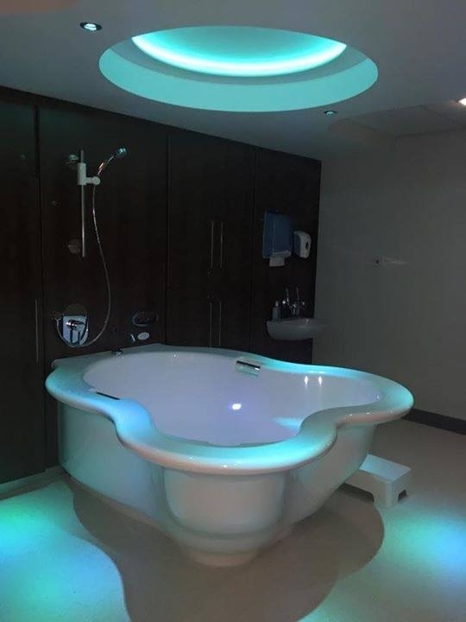
Birthing Pool
Advantages:
The warm water helps you to relax
Reduces adrenaline
Increases oxytocin and endorphins
Can reduce the need for further pain relief
Can help your labour to progress well & more comfortably
The buoyancy of the water helps you to adopt different positions and feel more comfortable
Limitations:
It is not recommended that women with certain complications use the pool
A minimum of 4 hours must pass after the use of diamorphine
Notes:
The birthing pool may be used at home (you would need to arrange hire of one) or at hospital. Since April 2016 water births have accounted for 3.4% of all deliveries at HDFT.
The midwife would discuss with you if they felt there was anything in your pregnancy or medical history that was inadvisable to use the pool. The list is not exhaustive but includes baby being in a breech position, raised blood pressure, significant meconium in the waters and the use of a hormone drip to augment (or improve) your contractions if infrequent.
In a COVID 19 positive woman we DO NOT advise use of the birthing pool.
The water temperature is kept to your comfort up to the point of birth, then it is kept to body temperature (37.0oC) so that your baby is born from an environment at the same temperature and is not stimulated to take their first breath until bought to the surface of the water.
There is only one birth pool at Harrogate, if you chose to use it then change your mind and which further pain relief choices that are not compatible with the pool (diamorphine and epidural) we are likely to move you to another room so that the pool is available for other women who may wish to use it. Let us know if the birthing pool is your preference.
We do not advise your birth partner to be in the water with you, in fact if they are you will have significantly less space to move around in.
It is important to keep well hydrated and empty your bladder regularly.

Slide 9
Diamorphine
What is it? Opioid analgesia
Advantages:
Starts to work after about 20 minutes
Can help the woman feel more relaxed
Can reduce the intensity of contractions
Lasts around 2 to 4 hours
Given with an anti-sickness injection
May have 2 doses 4 hours apart
Disadvantages:
Crosses the placenta
Most common side effects:
Drowsiness, nausea, vomiting, dizziness, constipation.
Notes:
The amount of drug we give you is dependant on your weight so we would need to know a current weight first.
As we know a common side effect is nausea and vomiting, we mix the diamorphine with a drug for this and they are both given in the same injection. If this anti sickness drug does not work well for you, there are other drugs that we can try.
As diamorphine crosses the placenta it may cause respiratory depression in the baby at birth. For most babies, simply drying at birth stimulates enough to start breathing spontaneously, a small proportion may need some ‘inflation’ breaths with air to stimulate them to breath regularly.
There is a drug that could be given to the baby to reverse the action of the diamorphine but this is exceptionally rarely used as the inflation breaths are sufficient stimulation.

Slide 10
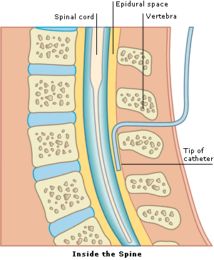
Epidural
What is it?
A continuous anaesthetic that numbs the nerves that carry the pain impulses from the birth canal to the brain
Administered by an Anaesthetist
22.6% of women choose to have an epidural (HDFT 2019)
Advantages:
For most women it gives complete pain relief
Disadvantages:
Cannula required
Heavy Legs
Difficulty passing urine – may need a catheter
Not always 100% effective (can experience break-through pain)
Side Effects:
Blood pressure can drop
1 in 200 women may get a headache afterwards
Notes:
The anaesthetist will want to have your informed consent prior to giving you an epidural, they will want you to have read through a information card and to have had the opportunity to ask any questions before starting the procedure. The anaesthetists will have an ODP (operating department practitioner) to assist them with the procedure.
You will need to get into a good position to open the vertebrae in your back for them to find the right place to site your epidural, we will work with your between your contractions but ask that you take instruction from your anaesthetist as they will ask you at times to sit still. The procedure is started by cleaning your back and putting a drape up to keep the area clean and minimise the risk of infection. Local anaesthetic is injected into the skin to numb the area, this usually feels like a sting. You should then just feel more pressure as the epidural is being sited.
The epidural is the piece of plastic left in your back, the needle is just used to get it into the right place and does not stay in your back. The anaesthetists will perform some checks to ensure it is in the right place before giving the first treatment dose. It may take up to 20 minutes to get the epidural in, then another 20 minutes for the first dose of the drug to work. The epidural attached to a pump that gives you a set dose over an hours period, every hour. As labour progresses, you may find your pain returns, in which case we can give additional doses of the drug to keep you comfortable.
The disadvantage of epidural is being confined to the bed so limits positions for active birth. The midwife will encourage and support you to change your position regularly by alternating between being sat, laid back and onto each side to encourage pressure relief from being in the same position for too long. You will not be able to get into an all fours position or get off the bed. An epidural may make the 2nd stage of labour (birthing phase) longer, many women still have a natural birth with an epidural.
A urinary catheter may be passed as the epidural can alter the sensations you would normally feel that your bladder needs empting or to empty it fully, if it is predicted that your baby's birth is sometime away we may introduce a catheter that stays in until the baby is ready to birth. You wont find this uncomfortable with the epidural in place.
We assess baby's well being by monitoring your baby with CTG (continuous monitoring) for 30 minutes after putting the epidural in, if this is normal and there is no other reason to continue to we then revert to listening to baby's heartbeat every 15 minutes for 1 minute after your contraction, as we would in care without epidural.
The epidural takes usually 2-6 hours to wear off completely at the point the medication has stopped, you should then be able to move around as normal, we ask you have someone with you at this time until we are sure that your sensation has treated to normal.
While there is an anaesthetist on call 24/7 for Delivery Suite, should another patient require urgent care then there may be a short delay in being able to site your epidural. If there is going to be a significant wait we will try our best to find a 2nd anaesthetist. You may need to consider other options for pain relief whilst waiting.

Slide 11
Birth Preference List
Over the coming weeks write your birth preference list together with your birth partner
The importance of ‘preference’ vs ‘plan’
Write in a chronological order
Try to keep it as concise as possible
This can be written in your green notes (pg. 29) or on a separate piece of paper
Advise what the midwife can do to help you
Would you like students involved in your care?
Notes:
On page 29 in your green maternity care books there is a section to consider your birth preferences, you may wish to discuss these with your birthing partner, so that way they will both be aware of your wishes and support your birthing partner to act as an advocate for you during labour and birthing.
Sometimes in a baby's birth, the journey can have twists and turns that are not always possible to predict, therefore your midwife may then advice you it may not be safe/possible to fulfil every request on your birth ‘plan’ and explain her rationale for why.

Slide 12
When Nature Needs a Hand
Notes:
This section is not designed to make you fearful but quite the opposite.
It is fact that worldwide, pregnancies and births may take twists and turns that mean we are advised to make choices or decisions we had hoped not to or hadn’t foreseen.
Many couples that come to class will start their labour spontaneously, birth naturally and never encounter any of the situations we will explore on the next few slides. Induction, instrumental birth and unplanned (emergency) caesarean sections are never going to be on your birth preferences, but similarly can never be ruled out 100% for any woman.
Understanding why and when we may advice these helps to frame the information and put it into perspective.
Often as we care for women, who perhaps do need a ventouse to assist their baby's safe birth, they say in hindsight having understood about the process from class, that it likely felt less daunting then if they had no knowledge or understanding of the process.

Slide 13
Why might we advise Induction of Labour (IOL)
Post term (term +12) at HDFT
Concerns with baby's movements- REMEMBER it is not true that baby moves less at the end of pregnancy- their movements should continue right up to your baby's birth
Static or tailing growth, small for gestational age baby
? Large for gestational age baby's
Pregnancy complications e.g., diabetes, raised blood pressure
Remember we are trying to get your body to do something it may not be ready to do!
Notes:
IOL starts on Pannal Ward. We call you that morning of the date you have been given to let you know what time we can accommodate starting your induction. If the unit is exceptionally busy this may be delayed till the evening or even the following day, we appreciate this is incredibly frustrating, as you had prepared for this with a date in mind, but this is for the safety of you, your baby and everyone else already in our care.

Slide 14
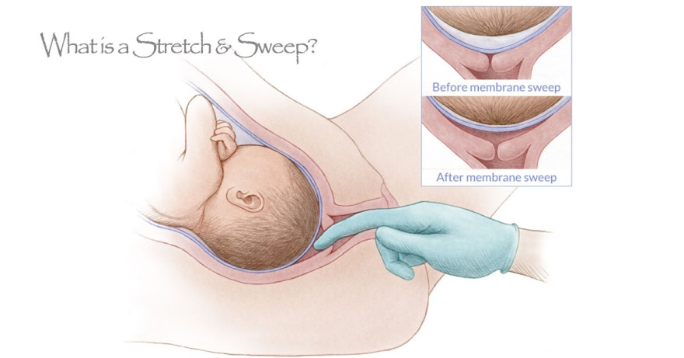
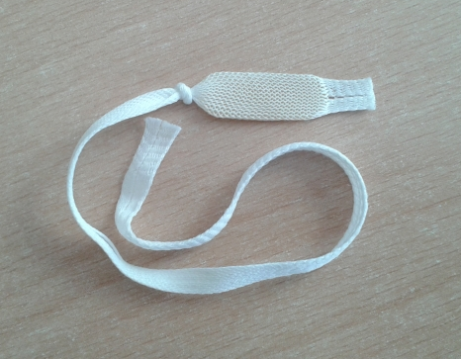
Induction of Labour (IOL)
Stretch & Sweep
Offered at 40 weeks & 41 weeks for primips (first babies)
Offered at 41 weeks for multips
(subsequent babies)
Propess Pessary offered at Term+12 unless clinically indicated sooner
Pessary containing an artificial hormone to help ripen the cervix
Inserted into the vagina by a midwife
Propess is removed after 24 hours and a second can be inserted for a further 24 hours if needed
Notes:
Stretch and sweep is where the midwife or doctor performs a vaginal examination, with your consent, this may be done at home, in ANC or on MAC. We would encourage you to have an empty bladder and rest back in a comfy position.
It is associated with an increase in the likelihood of spontaneous labour within 48 hours and of birth within 7 days. It is associated with a decrease in the need for a medical induction with prostaglandins. If you find it uncomfortable you can ask us to stop at any point, you are likely to have a heavy show and may experience some contractions over the next few hours.
The midwife will perform a vaginal examination to assess the cervix to help decide the most appropriate method of induction. If the cervix still has to complete making the changes for birth (effacement-coming forwards, losing length, thinning and softening, as discussed in Active Birth) Propess is suitable, a pessary will be inserted high in the vagina. It can remain for 24 hours, unless labour starts and it can easily be removed.
The pessary can cause some period like discomfort, generally a good sign that it is having some effect, but not labour. Keep distracted, listen to your body, rest if you feel you need it, otherwise keep active. Keep well hydrated and eat as normal. You may find a warm bath or using the TENS helps you feel a little more relaxed and comfier.
The baby’s heart rate will be monitored on a CTG a minimum of twice a day whilst the propess is insitu. The midwife will also carry out maternal observations regularly, and ask about contractions, PV loss & baby’s movements. There is a small risk of the uterus becoming over stimulated, if you feel you have constant tightening or discomfort in your abdomen let us know.
After 24 hours, there will be a second assessment. If it is still not possible to break the waters, a second propess will be inserted, and again, this can remain insitu for 24 hours.

Slide 15
Oupatient IOL
If you are induction at Term +12, and your pregnancy has been low risk AND you live within a 30 minute drive of the hospital you may be offered an OUTPATIENT IOL for the first 24 hours of the process
At home you will get more rest and likely feel more comfortable and relaxed, you may return to the ward at any point
You will receive a prescription for a few doses of codeine to help keep you comfortable
At 24 hours the IOL process continues in hospital

Slide 16
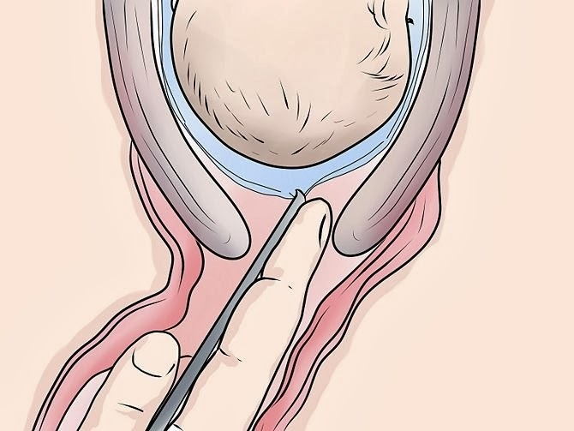
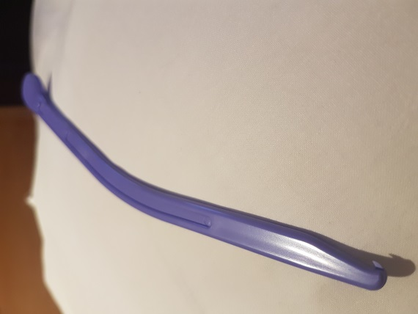
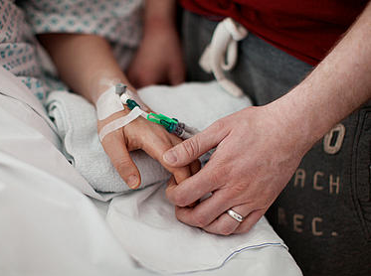
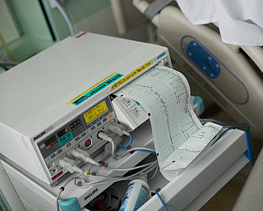
Induction of Labour
Artificial Rupture of Membranes (ARM)
Once the cervix has dilated enough it is possible to break your waters
Syntocinon Drip
A hormone drip administered intravenously
The midwife will titrate the amount given so that you have about 4 contractions every 10 minutes
Your baby will be continuously monitored throughout.
It is not possible to use the pool but keep active still!
Notes:
Once the cervix has completed the effacement process it may then be possible to break your waters- Artificial Rupture of Membranes or ARM, this may be done after the first Propess if sufficient change has been made or after the 2nd Propess.
At 48 hours i.e., 2 Propess being used, if ARM is not possible, we would then wait a further 24 hours then assess again if we can perform ARM. If still unable, we could consider using a 3rd Propess over another 24 hours.
If after 2-3 Propess being used the cervix still hasn’t effaced, ARM is not possible, then the IOL has not worked and we would then consider delivery baby by caesarean section.
After being able to perform ARM, we encourage you to be active and mobile for 2-6 hours in the hope that the uterus starts to contract regularly.
If this does not happen spontaneously we will then advise augmentation with a hormone drip of man made oxytocin (Syntocinon). You will need a drip so that we can give the drug intravenously. We do not advise use of the birthing pool and your baby’s well being will also be monitored continuously by CTG. We are trying to encourage regular uterine contractions, the drip is turned up gradually to give you and the baby chance to adjust, we are aiming for 4 contractions in a 10 minute period. The midwife will closely monitor contractions and you and your baby's well being. At the point of starting the Syntocinon drip, it is impossible to predict how quickly your body will react to it, it may take as little as a few hours or much longer. At the point the uterus is contracting regularly, we would assess the effect on the cervix after 4 hours.
We still encourage you to be active, there are wireless CTG monitors so ask if one is available, if not this does not mean you have to be laid on the bed, you can still stand, be in all fours, on a birthing ball with a wired monitor in use.

Slide 17
Potential IOL Timeline
Admitted for IOL-assessment and 1st Propess
at 24 hours -2nd assessment - 2nd Propess or ?ARM
at 48 hours -3rd assessment ARM possible
ARM not possible – rest for 24 hours
at 72 hours – assess again for ARM ARM possible- mobilise
ARM not possible- consider 3rd Propess
at 96 hours- assess again for ARM
Notes:
Remember we are trying to get your body to do something it is likely not ready to do itself, the process can take time, if it works quicker then great.

Slide 18
How to make IOL easier
Propess can give some period like discomfort, consider taking a warm bath or some paracetamol and codeine to help
Listen to your body, rest if you feel you can otherwise keep active
Use distraction techniques, watch a film, listen to music, go for a walk around the hospital
Keep calm, relaxed and patient
Consider outpatient IOL for first 24 hours (if suitable and meet HDFT criteria)

Slide 19
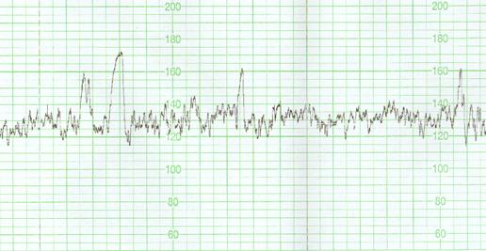
Monitoring babies heartrate
In uncomplicated pregnancy and birth, your midwife will listen to baby's heartrate every 15 minutes to the point of birthing, then at this point every 5 minutes
A CTG (cardiotocography) continuously monitors the fetal heart rate and contractions
Gives an overall picture of the baby’s wellbeing
Wireless monitoring is available
Mobilising is encouraged
Wireless monitoring can be performed in the pool if we are able to maintain good contact.
Notes:
We may monitor your baby's well being be listening to the heartbeat with either a Sonocaid device (as we do at you AN checks), a Pinnards stethoscope (perhaps your midwife has used one or you have seen one on Call the Midwife) or CTG,
A CTG (cardiotocography) allows for the continuous monitoring of the fetal heart rate and contractions; a normal trace is reassuring and indicates that the baby is coping well with labour.
Wireless monitoring is available but you may still be active with wired monitoring
The list is not exhaustive but we will advise CTG monitoring if :
Preterm labour (less than 37 weeks)
Baby in breech position
Multiple pregnancy
Small for gestational age, static growth or tailing growth
Gestational diabetes or pre-existing diabetes
Raised blood pressure
Use of Syntocinon
Presence of significant meconium
Any concerns about baby's well being from listening in as per normal care
Prolonged labour
Instrumental delivery
30 minutes trace after inserting epidural
All COVID 19 positive mums.

Slide 20
Instrumental Birth
An instrumental birth may be necessary if the second stage of labour is not progressing normally or there is a medical reason to limit the length of time mum is pushing
The baby may become distressed and need to be born quickly
Instrumental births account for 11% of births at Harrogate District Hospital (2019) either by ventouse or forceps
The appropriate instrument is used to deliver your baby safely, depending on the position of the baby and other factors, it is based on the clinicians assessment
We ensure you are comfortable for this procedure, if there is no epidural we are likely to recommend to you a spinal anaesthetic
We aim to deliver the baby in 3 contractions, you still need to push, we are simply assisting you and guiding the baby downwards

Slide 21
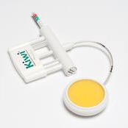
Ventouse
Forceps
Approximately 8% of babies born at Harrogate are by Forceps delivery
Approximately 3% of babies born at Harrogate are by Ventouse delivery.
(Statistics 2019)
Notes:
The baby is likely to have already developed some swelling in the soft tissues of the scalp as the skull bones have gently overlapped to make the baby's head smaller to fit through (as discussed in Active Birth), it is not the use of an instrument that has caused this.
Occasionally, the ventouse can leave a red mark on the baby's head or the forceps an mark on the head or the face, these fade after a few days / weeks.
If your doctor advises the baby will deliver easily with an instrument this is the safest option for you and your baby. To request a caesarean section at the point where baby can be delivered easily with an instrument (i.e., low in the pelvis) carries its own risk to both mum and baby if the head is deeply engaged in the pelvis and requires being pushed u vaginally at the time of caesarean.

Slide 22
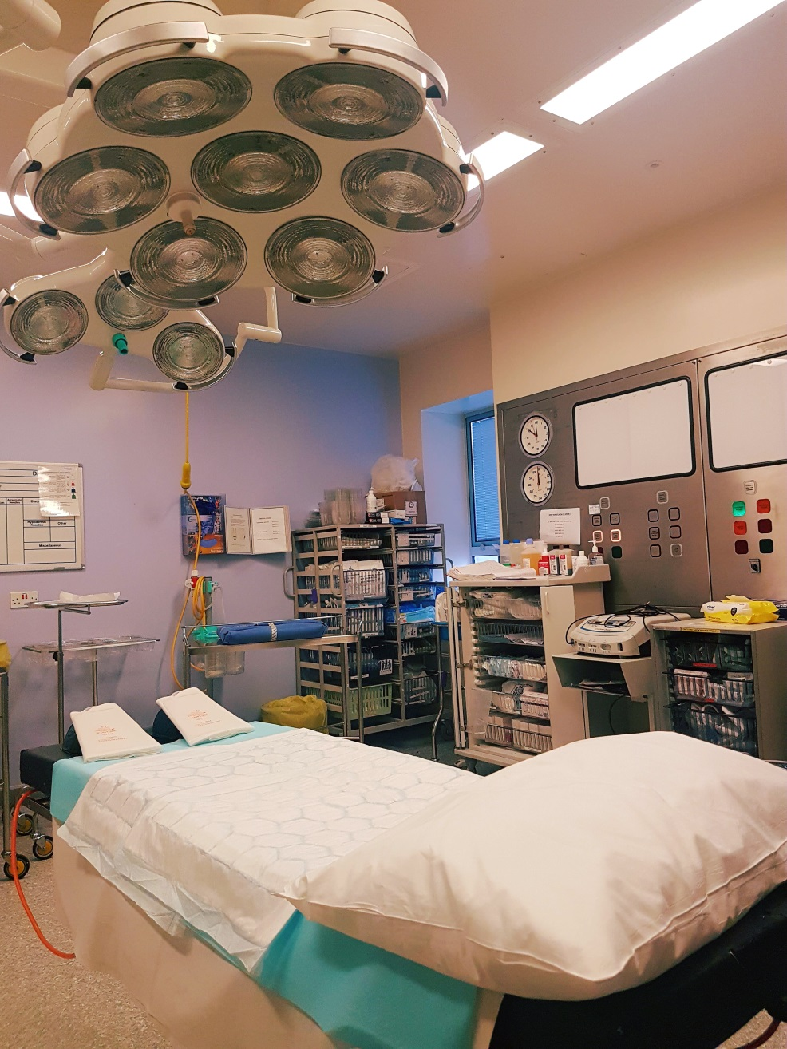
Caesarean
Approximately 14% of births are by Unplanned Caesarean Section & 15% by Planned Caesarean Section at Harrogate (total 29%)
There is a theatre on delivery suite
A spinal anaesthetic is given by an anaesthetist
An indwelling catheter is inserted to keep the bladder empty, removed once the spinal wears off
An incision is made into the lower abdomen
You can still have delayed cord clamping and skin to skin in theatre.
Inpatient for 24-48 hours
Initial care in the bay (side rooms available after 24 hours, if available and amenity charge applied)
(Statistics 2019)
Notes:
In addition to Mum, the birth partner, and the midwife, there may be up to 8 other members of staff involved in your care to take you to theatre, this is normal and everyone has a role to play in your care.
You will be in theatre around 1 hour, from starting the operation baby is normally born in 3-7 minutes, it takes much longer to close all the layers until the end of the operation. You will usually be able to have one birth partner with you for support, they will be shown where to sit and instructed how to ensure we keep the area around you sterile.
We place a screen over your chest and drape the area to keep it sterile, the surgeon will left the baby so you can see them as we have a period of delayed cord clamping, the cord is then clamped and cut by the surgeon and the baby is taken to the corned of the room to dry them off to help minimise them losing their body heat. If the screen is up it can be difficult to start skin to skin immediately but we can try to facilitate this if you wish, or your partner may hold baby until the point we can get you into bed and baby skin to skin with you then.
There will be regular observations of your well being for the next 20 minutes with the ODP and the midwife, then you will have some time as a family in between the midwife supporting you in feeding your baby and continuing to monitor your well being post operatively.

Slide 23
The Role of the Birth Partner
The presence of a supportive birth partner has been shown to decrease a woman’s need for pain relief and to enhance her experience of childbirth.
Therefore it is important to feel prepared and understand what the role of the birth partner may entail.
To do:
…………………………..
…………………………..
…………………………..
…………………………..
Notes:
Have a chat about your expectations and how each of you may feel.
Remember-
helping your partner to prepare for birth through self belief
encourage and support your partner in practising deep breathing and relaxation practise during the rest of the pregnancy
- encouraging rest in the early phases
encouraging and supporting active birth positions
building the nest and all that entails
bladder care
monitoring doses of paracetamol
massage
reassurance- particularly in transition
hydration and nutrition
taking time for yourself to rest and eat
At the point your midwife becomes involved in your care, we are there to support, please continue doing all these amazing roles to support your partner through birth

Slide 24
Contact Numbers:
Maternity Assessment Centre (MAC)
01423 557531 / 557548
Labour Ward
01423 553184 / 553185
Pannal Ward
01423 553157
Community Midwives
01423 553051

