Slide 1
Harrogate Town Centre Overnight “out of hours” Closure Summary
Version 1.04
Released 24.07.2019
James Gilroy
All timings are subject to change
For internal planning purposes only

Slide 2
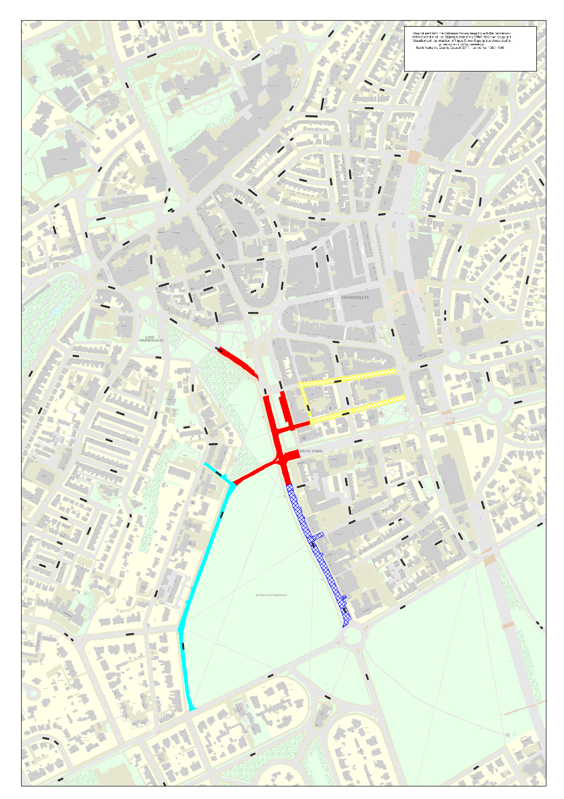
Harrogate Town Centre Overnight Closures & Traffic Management MASTER September 2019
Raglan Street & Albert Street
Access to Parliament Street via Raglan Street
Finish Line Area
Closed 18.09.2019 to 01.10.2019
Tower Street and Belford Street
Local Access Only
Beech Grove
Resident access only
West Park
Managed access only
Timings Subject to change dependent on race speed / crowd levels and traffic levels
For more information see
www.yokrshire2019.co.uk
@yorkshire2019travel

Slide 3
Harrogate Town Centre Overnight Closures & Traffic Mgmt
1800 Friday 20th to 0600 Saturday 21st September 2019
Key
2 Way Traffic in place for event
1 Way Traffic in place for event
Raglan Street & Albert Street
Access to Parliament Street via Raglan Street
One way system in operation
Finish Line Area
Closed 18.09.2019 to 01.10.2019
Tower Street and Belford Street
Two Way Traffic Local Access Only
Beech Grove
Resident access only
West Park
Managed access only
Timings Subject to change dependent on race speed / crowd levels and traffic levels
For more information see
www.yokrshire2019.co.uk
@yorkshire2019travel

Slide 4
Harrogate Town Centre Overnight Closures & Traffic Mgmt
1900 Saturday 21st to 0400 Sunday 22nd September 2019
Key
2 Way Traffic in place for event
1 Way Traffic in place for event
Raglan Street & Albert Street
Access to Parliament Street via Raglan Street
One way system in operation
Finish Line Area
Closed 18.09.2019 to 01.10.2019
Tower Street and Belford Street
Two Way Traffic Local Access Only
Beech Grove
Resident access only
West Park
Managed access only

Slide 5
Harrogate Town Centre Overnight Closures & Traffic Mgmt
1800 Sunday 22nd to 0700 Monday 23rd September 2019
Key
2 Way Traffic in place for event
1 Way Traffic in place for event
Raglan Street & Albert Street
Access to Parliament Street via Raglan Street
One way system in operation
Finish Line Area
Closed 18.09.2019 to 01.10.2019
Tower Street and Belford Street
Two Way Traffic Local Access Only
Beech Grove
Resident access only
West Park
Managed access only
Timings Subject to change dependent on race speed / crowd levels and traffic levels
For more information see
www.yokrshire2019.co.uk
@yorkshire2019travel

Slide 6
Harrogate Town Centre Overnight Closures & Traffic Mgmt
1830 Monday 23rd to 0700 Tuesday 24th September 2019
Key
2 Way Traffic in place for event
1 Way Traffic in place for event
Raglan Street & Albert Street
Access to Parliament Street via Raglan Street
One way system in operation
Finish Line Area
Closed 18.09.2019 to 01.10.2019
Tower Street and Belford Street
Two Way Traffic Local Access Only
Beech Grove
Resident access only
West Park
Managed access only
Timings Subject to change dependent on race speed / crowd levels and traffic levels
For more information see
www.yokrshire2019.co.uk
@yorkshire2019travel

Slide 7
Harrogate Town Centre Overnight Closures & Traffic Mgmt
1900 Tuesday 24th to 0700 Wednesday 25th September 2019
Key
2 Way Traffic in place for event
1 Way Traffic in place for event
Raglan Street & Albert Street
Access to Parliament Street via Raglan Street
One way system in operation
Finish Line Area
Closed 18.09.2019 to 01.10.2019
Tower Street and Belford Street
Two Way Traffic Local Access Only
Beech Grove
Resident access only
West Park
Managed access only

Slide 8
Harrogate Town Centre Overnight Closures & Traffic Mgmt
1800 Wednesday 25th to 1030 Thursday 26th September 2019
Key
2 Way Traffic in place for event
1 Way Traffic in place for event
Raglan Street & Albert Street
Access to Parliament Street via Raglan Street
One way system in operation
Finish Line Area
Closed 18.09.2019 to 01.10.2019
Tower Street and Belford Street
Two Way Traffic Local Access Only
Beech Grove
Resident access only
West Park
Managed access only
Timings Subject to change dependent on race speed / crowd levels and traffic levels
For more information see
www.yokrshire2019.co.uk
@yorkshire2019travel

Slide 9
Harrogate Town Centre Overnight Closures & Traffic Mgmt
1800 Thursday 26th to 0800 Friday 27^{h} September 2019
Key
2 Way Traffic in place for event
1 Way Traffic in place for event
Raglan Street & Albert Street
Access to Parliament Street via Raglan Street
One way system in operation
Finish Line Area
Closed 18.09.2019 to 01.10.2019
Tower Street and Belford Street
Two Way Traffic Local Access Only
Beech Grove
Resident access only
West Park
Managed access only
Timings Subject to change dependent on race speed / crowd levels and traffic levels
For more information see
www.yokrshire2019.co.uk
@yorkshire2019travel

Slide 10
Harrogate Town Centre Overnight Closures & Traffic Mgmt
2130 Friday 27th to 0630 Saturday 28^{h} September 2019
Key
2 Way Traffic in place for event
1 Way Traffic in place for event
Raglan Street & Albert Street
Access to Parliament Street via Raglan Street
One way system in operation
Finish Line Area
Closed 18.09.2019 to 01.10.2019
Tower Street and Belford Street
Two Way Traffic Local Access Only
Beech Grove
Resident access only
West Park
Managed access only

Slide 11
Harrogate Town Centre Overnight Closures & Traffic Mgmt
1800 Saturday 28th to 0900 Sunday 29^{h} September 2019
Key
2 Way Traffic in place for event
1 Way Traffic in place for event
Raglan Street & Albert Street
Access to Parliament Street via Raglan Street
One way system in operation
Finish Line Area
Closed 18.09.2019 to 01.10.2019
Tower Street and Belford Street
Two Way Traffic Local Access Only
Beech Grove
Resident access only
West Park
Managed access only
Timings Subject to change dependent on race speed / crowd levels and traffic levels
For more information see
www.yokrshire2019.co.uk
@yorkshire2019travel

Slide 12
Harrogate Town Centre Overnight Closures & Traffic Mgmt
2359 Sunday 29th to 0800 Monday 30th September 2019
Key
2 Way Traffic in place for event
1 Way Traffic in place for event
Raglan Street & Albert Street
Access to Parliament Street via Raglan Street
One way system in operation
Finish Line Area
Closed 18.09.2019 to 01.10.2019
Tower Street and Belford Street
Two Way Traffic Local Access Only
Beech Grove
Resident access only
West Park
Managed access only
Timings Subject to change dependent on race speed / crowd levels and traffic levels
For more information see
www.yokrshire2019.co.uk
@yorkshire2019travel

Slide 13
Harrogate Town Centre Overnight Closures & Traffic Mgmt
2000 Monday 30th September 2019 to 0600 Tuesday 1st October 2019
Key
2 Way Traffic in place for event
1 Way Traffic in place for event
Raglan Street & Albert Street
Access to Parliament Street via Raglan Street
One way system in operation
Finish Line Area
Closed 18.09.2019 to 01.10.2019
Tower Street and Belford Street
Two Way Traffic Local Access Only
Beech Grove
Resident access only
West Park
Managed access only
Timings Subject to change dependent on race speed / crowd levels and traffic levels
For more information see
www.yokrshire2019.co.uk
@yorkshire2019travel

