Slide 1
Harrogate Town Centre Closure Summary
Version 1.04
Released 24.07.2019
James Gilroy
All timings are subject to change
For internal planning purposes only

Slide 2
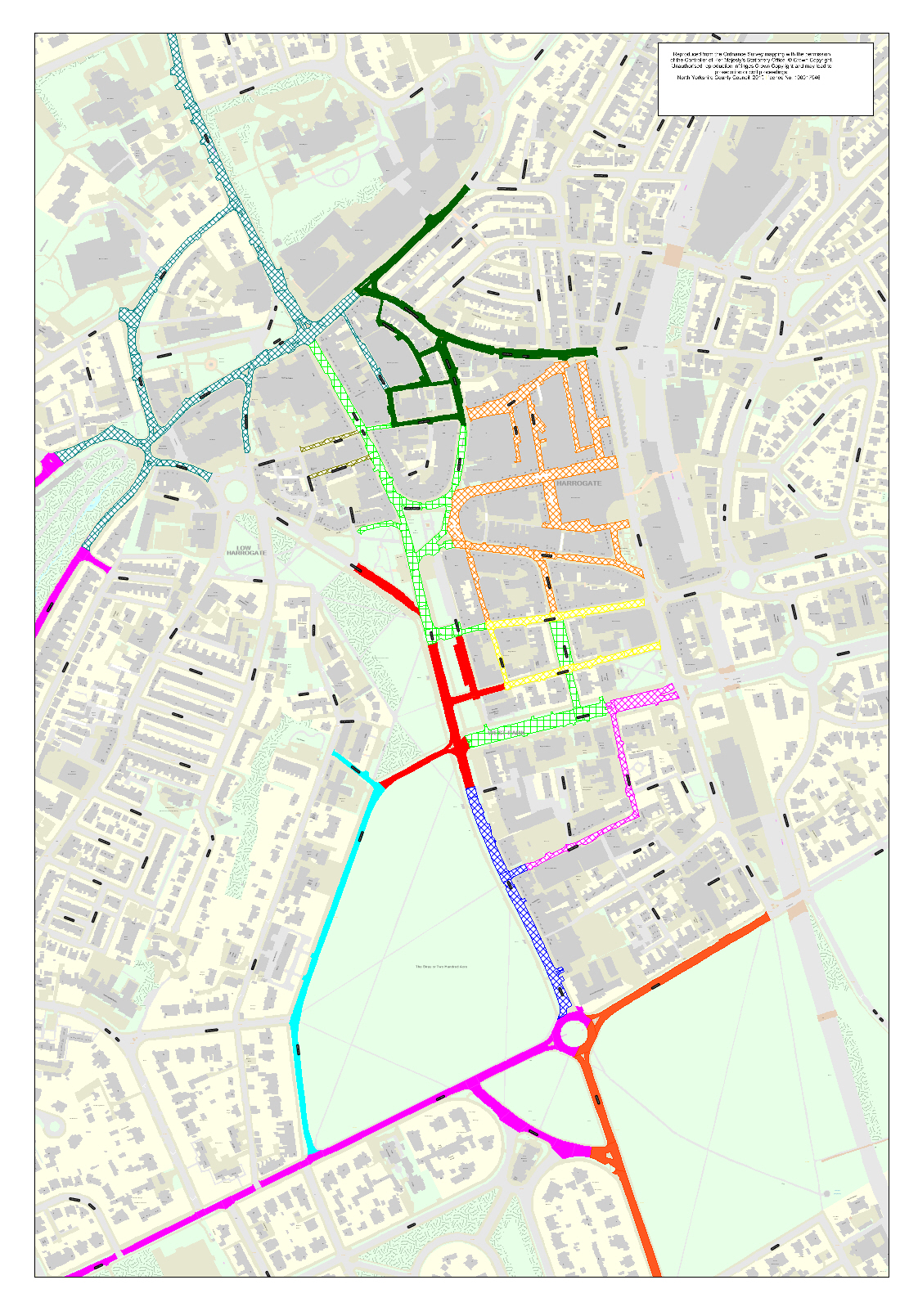
Harrogate Town Centre Road Closures Saturday 21st September 2019
Ripon Road Sector
Closed 0700-1830
See circuit Map for vehicle crossing Point info
Key
2 Way Traffic in place for event
Deviation Route Closure
Closed 0830-1100
Closed 1330-1730
1 Way Traffic in place for event
Main Shopping Area
No Vehicle Access
0830-1930
Race Areas + Team Parking
Closed 0600-1930
Raglan Street & Albert Street
Closed 0830-1100
Closed 1130-1730
The Ginnel & Parliament Terrace
Resident Access Only 0600-1900 via Montpellier
Finish Line Area
Closed 18.09.2019 to 01.10.2019
Tower Street and Belford Street
Local Access Only
Beech Grove
Resident access only
West Park
Closed 0600-1900
Managed access only outside of these times via Tower Street
York Place / Leeds Road
One Way York Place to Leeds Road
0700-0830 & 1100-1200
Closed 0830-1100
Otley Road Race Route
Closed 0700-1200
See Circuit Map for vehicle Crossing Point Info
Timings Subject to change dependent on race speed / crowd levels and traffic levels
For more information see
www.yokrshire2019.co.uk
@yorkshire2019travel

Slide 3
Harrogate Town Centre Closures Sunday 22nd
September 2019
Ripon Road Sector
Closed 1030-1740
See circuit Map for vehicle crossing Point info
Key
2 Way Traffic in place for event
Deviation Route Closure
Closed 1200-1640
1 Way Traffic in place for event
Main Shopping Area
No Vehicle Access
0400-1800
Race Areas + Team Parking
Closed 0400-1800
Raglan Street & Albert Street
Closed 1200-1640
The Ginnel & Parliament Terrace
Resident Access Only 0400-1800 via Montpellier
Finish Line Area
Closed 18.09.2019 to 01.10.2019
Tower Street and Belford Street
Local Access Only
Closed 1200-1640
Beech Grove
Resident access only
West Park
Closed 0400-1800
Managed access only outside of these times via Tower Street
York Place / Leeds Road
One Way York Place to Leeds Road
0700-1200 & 1640-1740
Closed 1200-1640
Otley Road Race Route
Closed 0700-1740
See Circuit Map for vehicle Crossing Point Info
Timings Subject to change dependent on race speed / crowd levels and traffic levels
For more information see
www.yokrshire2019.co.uk
@yorkshire2019travel

Slide 4
Harrogate Town Centre Closures Monday 23rd September 2019
Ripon Road Sector
Closed 0800-1740
See circuit Map for vehicle crossing Point info
Key
2 Way Traffic in place for event
Deviation Route Closure
Closed 0930-1145
Closed 1230-1640
1 Way Traffic in place for event
Main Shopping Area
No Vehicle Access 0900-1800
Race Areas + Team Parking
Closed 0700-1830
Raglan Street & Albert Street
Closed 0930-1145
Closed 1300-1610
The Ginnel & Parliament Terrace
Resident Access Only
Finish Line Area
Closed 18.09.2019 to 01.10.2019
Tower Street and Belford Street
Closed 0930-1145
Closed 1230-1640
Local Access Only
Beech Grove
Resident access only
West Park
Closed 0700-1830
Managed access only outside of these times via Tower Street
York Place / Leeds Road
One Way York Place to Leeds Road
0800-0930, 1145-1230 & 1640-1740
Closed 0930-1145
Closed 1230-1640
Otley Road Race Route
Closed 0800-1740
See Circuit Map for vehicle Crossing Point Info
Timings Subject to change dependent on race speed / crowd levels and traffic levels
For more information see
www.yokrshire2019.co.uk
@yorkshire2019travel

Slide 5
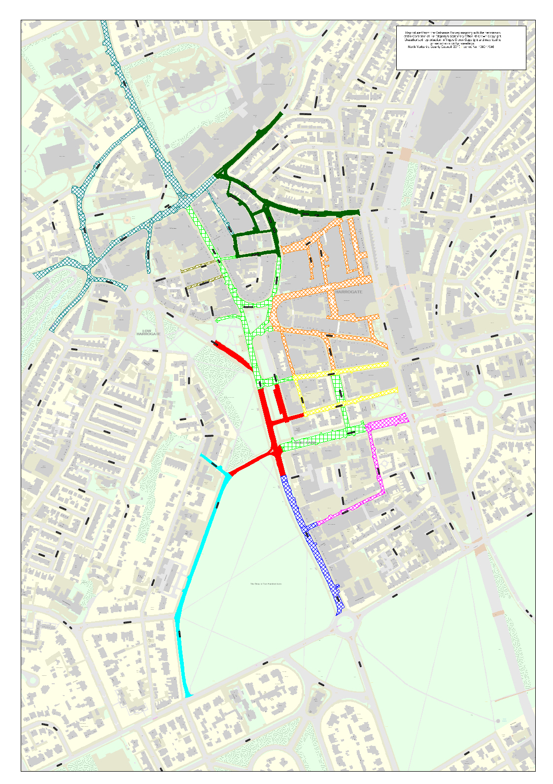
Saturday 21st September
Harrogate Town Centre Closures Tuesday 24th September 2019
Key
Ripon Road Sector
Closed 0830-1815
See circuit Map for vehicle crossing Point info
2 Way Traffic in place for event
1 Way Traffic in place for event
Deviation Route Closure
Closed 0930-1230
Closed 1400-1700
Main Shopping Area
No Vehicle Access 0900-1900
Race Areas + Team Parking
Closed 0700-1900
The Ginnel & Parliament Terrace
Resident Access Only 0400-1900 via Montpellier
Raglan Street & Albert Street
Closed 0930-1230
Closed 1400-1700
Finish Line Area
Closed 18.09.2019 to 01.10.2019
Tower Street and Belford Street
Local Access Only
Beech Grove
Resident access only
West Park
Closed 0700-1900
Managed access only outside of these times via Tower Street
Timings Subject to change dependent on race speed / crowd levels and traffic levels
For more information see
www.yokrshire2019.co.uk
@yorkshire2019travel

Slide 6
Harrogate Town Centre Closures Wednesday 25th
September 2019
Ripon Road Sector
Closed 0830-1710
See circuit Map for vehicle crossing Point info
Key
2 Way Traffic in place for event
Deviation Route Closure
Closed 0930-1200
Closed1300-1600
1 Way Traffic in place for event
Main Shopping Area
No Vehicle Access 0900-1800
Race Areas + Team Parking
Closed 0700-1800
Raglan Street & Albert Street
Closed 0930-1200
Closed 1300-1600
The Ginnel & Parliament Terrace
Resident Access Only via Montpellier 0700-1800
Finish Line Area
Closed 18.09.2019 to 01.10.2019
Tower Street and Belford Street
Local Access Only
Beech Grove
Resident access only
West Park
Closed 0700-1800
Managed access only outside of these times via Tower Street
York Place / Leeds Road
One Way York Place to Leeds Road
0900-0930 & 1200-1300
Closed 0930-1200
Otley Road Race Route
Closed 0900-1300
See Circuit Map for vehicle Crossing Point Info
Timings Subject to change dependent on race speed / crowd levels and traffic levels
For more information see
www.yokrshire2019.co.uk
@yorkshire2019travel

Slide 7
Harrogate Town Centre Closures Thursday 26th
September 2019
Ripon Road Sector
Closed 1245-1700
See circuit Map for vehicle crossing Point info
Key
2 Way Traffic in place for event
Deviation Route Closure
Closed 1400-1600
1 Way Traffic in place for event
Main Shopping Area
No Vehicle Access 1030-1800
Race Areas + Team Parking
Closed 1030-1800
Raglan Street & Albert Street
Closed 1400-1600
The Ginnel & Parliament Terrace
Resident Access Only via Montpellier
1030-1800
Finish Line Area
Closed 18.09.2019 to 01.10.2019
Tower Street and Belford Street
Local Access Only
Beech Grove
Resident access only
West Park
Closed 1030-1800
Managed access only outside of these times via Tower Street
York Place / Leeds Road
One Way York Place to Leeds Road
Closed
Otley Road Race Route
Closed 1245-1700
See Circuit Map for vehicle Crossing Point Info
Timings Subject to change dependent on race speed / crowd levels and traffic levels
For more information see
www.yokrshire2019.co.uk
@yorkshire2019travel

Slide 8
Harrogate Town Centre Closures Friday 27th
September 2019
Ripon Road Sector
Closed 0900-1300
Closed 1545-2030
See circuit Map for vehicle crossing Point info
*Swan Rd / Crescent Rd may be closed 1300-1545
Key
2 Way Traffic in place for event
Deviation Route Closure
Closed 1030-1130
Closed 1750-1930
1 Way Traffic in place for event
Main Shopping Area
No Vehicle Access 0900-2130
Race Areas + Team Parking
Closed 0800-2130
Raglan Street & Albert Street
Closed 1030-1130
Closed 1750-1930
The Ginnel & Parliament Terrace
Resident Access Only via Montpellier
0800-2100
Finish Line Area
Closed 18.09.2019 to 01.10.2019
Tower Street and Belford Street
Local Access Only
Beech Grove
Resident access only
West Park
Closed 0800-2130
Managed access only outside of these times via Tower Street
York Place / Leeds Road
One Way York Place to Leeds Road
1545-1715 & 1930-2030
Closed 1715-1930
Otley Road Race Route
Closed 1545-1715
See Circuit Map for vehicle Crossing Point Info
Timings Subject to change dependent on race speed / crowd levels and traffic levels
For more information see
www.yokrshire2019.co.uk
@yorkshire2019travel

Slide 9
Harrogate Town Centre Closures Saturday
28th September 2019
Ripon Road Sector
Closed 1200-1710
See circuit Map for vehicle crossing Point info
Key
2 Way Traffic in place for event
Deviation Route Closure
Closed 1330-1610
1 Way Traffic in place for event
Main Shopping Area
No Vehicle Access
1000-1800
Race Areas + Team Parking
Closed 1100-1800
Raglan Street & Albert Street
Closed 1330-1610
The Ginnel & Parliament Terrace
Resident Access Only via Montpellier
1200-1710
Finish Line Area
Closed 18.09.2019 to 01.10.2019
Tower Street and Belford Street
Local Access Only
Beech Grove
Resident access only
West Park
Closed 1100-1800
Managed access only outside of these times via Tower Street
York Place / Leeds Road
Closed 1200-1710
Otley Road Race Route
Closed 1200-1710
See Circuit Map for vehicle Crossing Point Info
Timings Subject to change dependent on race speed / crowd levels and traffic levels
For more information see
www.yokrshire2019.co.uk
@yorkshire2019travel

Slide 10
Harrogate Town Centre Closures Sunday 29th September
Ripon Road Sector
Closed1030-1800
See circuit Map for vehicle crossing Point info
Key
2 Way Traffic in place for event
Deviation Route Closure
Closed 1200-1700
1 Way Traffic in place for event
Main Shopping Area
No Vehicle Access
0900-2000
Race Areas + Team Parking
Closed 0900-2359
Raglan Street & Albert Street
Closed 1200-2000
The Ginnel & Parliament Terrace
Resident Access Only via Montpellier 0900-2359
Finish Line Area
Closed 18.09.2019 to 01.10.2019
Tower Street and Belford Street
Local Access Only
Beech Grove
Resident access only
West Park
Closed 0900-2359
Managed access only outside of these times via Tower Street
York Place / Leeds Road
One Way York Place to Leeds Road
Closed 1030-1800
Otley Road Race Route
Closed 1030-1800
See Circuit Map for vehicle Crossing Point Info
Timings Subject to change dependent on race speed / crowd levels and traffic levels
For more information see
www.yokrshire2019.co.uk
@yorkshire2019travel

Slide 11
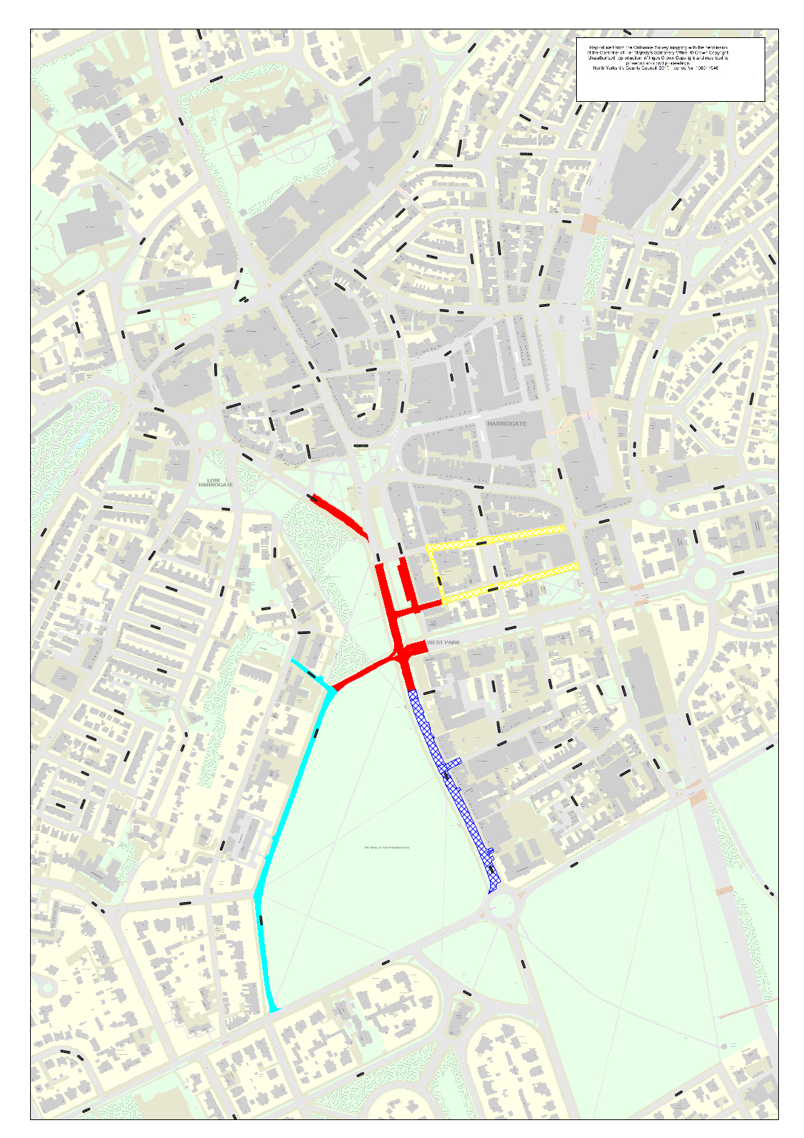
Harrogate Town Centre Closures & Traffic Mgmt
0800 Monday 30th to 2000 Monday 30th September 2019
Key
2 Way Traffic in place for event
1 Way Traffic in place for event
Raglan Street & Albert Street
Access to Parliament Street via Raglan Street
One way system in operation
Finish Line Area
Closed 18.09.2019 to 01.10.2019
Tower Street and Belford Street
Two Way Traffic Local Access Only
Beech Grove
Resident access only
West Park
Managed access only

Slide 12
Harrogate Town Centre Closures MASTER TEMPLATE
September 2019
Ripon Road Sector
Closed
See circuit Map for vehicle crossing Point info
Key
2 Way Traffic in place for event
Deviation Route Closure
Closed
Closed
1 Way Traffic in place for event
Main Shopping Area
No Vehicle Access
Race Areas + Team Parking
Closed
Raglan Street & Albert Street
Closed
Closed
The Ginnel & Parliament Terrace
Resident Access Only via Montpellier
Finish Line Area
Closed 18.09.2019 to 01.10.2019
Tower Street and Belford Street
Local Access Only
Beech Grove
Resident access only
West Park
Closed
Managed access only outside of these times via Tower Street
York Place / Leeds Road
One Way York Place to Leeds Road
Closed
Otley Road Race Route
Closed
See Circuit Map for vehicle Crossing Point Info
Timings Subject to change dependent on race speed / crowd levels and traffic levels
For more information see
www.yokrshire2019.co.uk
@yorkshire2019travel

