Slide 1
Governor Questions 7th August 2019

Slide 2
There are considerable waiting list issues with services such as Autism (2years) Paediatric Dental (1yr). How assured are NEDs that there is sufficient attention being paid to managing waiting lists (in general) that would be deemed unacceptable, the potential impact on patients and that there is a more robust strategy going forward
1

Slide 3
Waiting times (1/3)
Waiting time expectations are set by NHS England and local commissioners.
The oversight of waiting times takes place on a weekly basis through the Operational Performance meeting which is chaired by the Chief Operating Officer.
This brings together the information from services within the Directorate teams to enable an understanding of capacity constraints, changes in demand and any resulting impact on the length of wait for urgent care, Cancer care and planned care. Where specific actions are required it is agreed through this group and monitored weekly.
In addition, the constitutional standards (RTT) are fully reported within the Integrated Board Report which goes to Senior Management Team, Quality Committee and the Board of Directors on a monthly basis and is publically reported.
Where waiting times are not directly included within the constitutional standards (including autism and dentistry), local waiting times are monitored. Where these are identified as a risk they are escalated through the risk management process.

Slide 4
Waiting times (2/3)
An example of this has been the waiting times for AHD assessments which were identified from the directorate risk register; and was escalated to the Board in January 2019. The Trust was commissioned for a specific number of assessments, but higher demand resulted in long waits.
This resulted in the Trust having to suspend the acceptance of new referrals from the Hambleton and Richmondshire area until a plan was agreed with commissioners.
We ran a rapid improvement week applying our quality improvement approach and the clinical team refined the process into a pathway with four streams. This reduced the need for face to face contact by 44% so the service has more capacity to assess children with no new resources. This means that we are able to offer enough capacity to match current demand, although we need to monitor what happens to demand.
We have also agreed a plan to assess those children who have been waiting for a long time, and commissioners have provided one-off funding for this. We expect waiting times to fall from now, and by July 2020 waiting times should be no more than 3 months (assuming demand does not change)

Slide 5
Waiting times (3/3)
In respect of Dental waiting times, the Trust has continued to work with NHS England and had agreed funding to support waiting list initiatives on a number of occasions. However, the challenges recruiting sufficient dentists, particularly in locations such as Scarborough, continues to affect the waiting times. The oversight of Dental waiting times will be simplified from October 2019 when all pathways will be deemed consultant led and as such will all be reported through the same mechanism.
Waiting times have been rising nationally for a number of years, and this is also the case in Harrogate because of both the funding available and the availability of workforce. In a number of performance standards continues to be ahead of the national position, however, the waiting times for routine procedures are closer to the national average, but still lower (92nd centile wait is 23 weeks and median is 8 weeks nationally, HDFT is 21 weeks and 6 weeks).
The Planned care transformation programme which continues to develop with commissioners, is seeking to ensure that demand is managed effectively and that pathways or care are as efficient as possible to maximise the use of available resources.

Slide 6
In the context of current plans for the UK to leave the EU on 31 October, what assurance can the Trust give that appropriate plans are in place to ensure continuity of supply in relation to all medicines and medical supplies in the event of a no-deal scenario and that patients will not be negatively affected?
2

Slide 7
EU Exit preparations (1/2)
The Department for Health and Social Care is the lead agency for contingency planning and is directing the NHS in respect of preparations . NHS England has established an EU Exit Team which is led by Professor Keith Willett. The central team are responsible for coordination of the national response including supply lines and contingency planning, particularly the supply of medical devices and medicines, with 75% of those products being sourced from EU countries at present.
Trusts have been directed that they should not stockpile supplies in advance of EU Exit, that clinicians should not write longer NHS prescriptions and the public should not stockpile. More recent communication has indicated that further guidance will be issued towards the end of August.
The Board received a full update on the Trusts preparations for the EU Exit at the meeting in March, in advance of the original planned leave date. This included an update on the desktop exercise to test the Trusts business continuity plans. The Trust has an EU Exit planning team in place, led by the Trusts Chief Operating Officer, the SRO for EU Exit and Accountable Emergency Officer.

Slide 8
EU Exit preparations (2/2)
Some examples of the actions being taken by the DHSC and industry are:
Companies were asked to ensure they have a minimum of six weeks’ additional supply in the UK, over and above their business as usual buffer stocks, and asked to make arrangements to air freight medicines with a short shelf life, such as medical radioisotopes.
The Government has secured additional roll-on, roll-off ferry capacity between the UK and EU specifically for critical goods such as medicines
The Government has agreed that medicines and medical products will be prioritised on these alternative routes to ensure the flow of all these products will continue. This includes all medicines, including general sales list medicines.
The Government has confirmed that, in the event of any disruption at the border, medicines will be prioritised.

Slide 9
Can the NEDs assure the public how the Trust continuously improves services in a responsive manager following patient feedback, complaints and serious incidents; it would help to have regular supporting statistics, examples of improvements and typical elapsed times from being raised to embedding change
3

Slide 10
Learning (1/2)
The Quality Committee provides assurance in respect of the Trust’s approach to learning from complaints, national patient experience surveys, local friends and family test for satisfaction, incidents and serious incidents and receives a comprehensive quarterly report. There are similar arrangements in place at a directorate level.
Annually, a summary is provided in the Trust’s Quality Account which is publicly available and is also shared with all local stakeholders.
The Board is notified of all serious incidents, and a non-executive director oversees the progress of the investigation, and these are all reported to the Board.
In respect of learning these reports also track the implementation of actions arising from the investigation of complaints and serious incidents.

Slide 11
Learning (2/2)
Each serious incident has a set of agreed actions which are monitored at SMT to ensure progress is made. The learning is summarised in a simple an accessible way known as “learning on a page”. Each SI also includes a plan for audit to check that any actions taken have been embedded approx. 6 months after the report is finalised.
For SI’s in 2017/18 there is only one action which is still to be completed, and for SI’s on 2018/19 there is one SI which has some outstanding actions. These were discussed at SMT and support is being provided to ensure they are completed.
In respect of the audit process, by way of an example there was a recent audit following an SI which was reviewed at CORM. One of the issues in the SI was that we did not have access to the mother’s medical record from previous C-section at Leeds and if we had had this information, it may have affected management of the case. Following the SI investigation a process was introduced to ensure we routinely request and receive notes for relevant mothers. In reviewing the results of the audit, it was agreed that positive steps had been taken, but further work is needed to ensure this process is robust and happening consistently, so a re-audit has been requested for a further 6 months’ time. This will go back to CORM for discussion once completed by the maternity department.
Similarly, each complaint has an agreed set of agreed actions which are monitored at SMT to ensure progress is made. The processing of auditing for impact is focused on more serious complaints rather than all complaints.

Slide 12
How are the NEDs assured regarding the Trust’s preparations for a significant increase in influenza cases in the coming Winter period, in light of the current experience in Australia, which tends to be repeated in the UK?
4

Slide 13
Influenza preparations (1/3)
The arrangements for influenza preparation are reviewed by the Board on an annual basis, which includes a review of the previous year and the plans for the forthcoming influenza season.
There are 4 key components to these arrangements - (i) protecting vulnerable patients through vaccination, (ii) vaccination of staff, (iii) treating patients with flu promptly and (iv) the plan to manage any ‘surge’ in admissions. The Trust has a specific plan for managing extreme pressures due to influenza. The plans are due to be considered by the Board at the August workshop. Jenny Childs, our medical microbiology lead is supporting the development of the plan.
In 2018/19 the vaccination rate for frontline workers in HDFT was at its highest level at 61.7% which was the compared to the national expectation that 75% of staff would be vaccinated. National uptake was 70.3%
37 peer vaccinators delivered half of the total number of flu vaccinations.
63% of doctors, 60% of nurses, 61% of support workers and 68% of other clinical workers had their flu vaccination.
47% of those who told us why they didn’t have the vaccination said it was due to personal choice or because of concerns about the side effects. Only 3% said they had an allergy or were vegan.

Slide 14
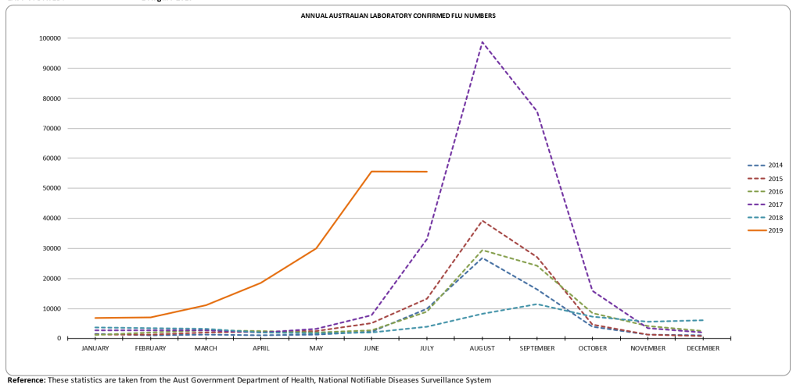
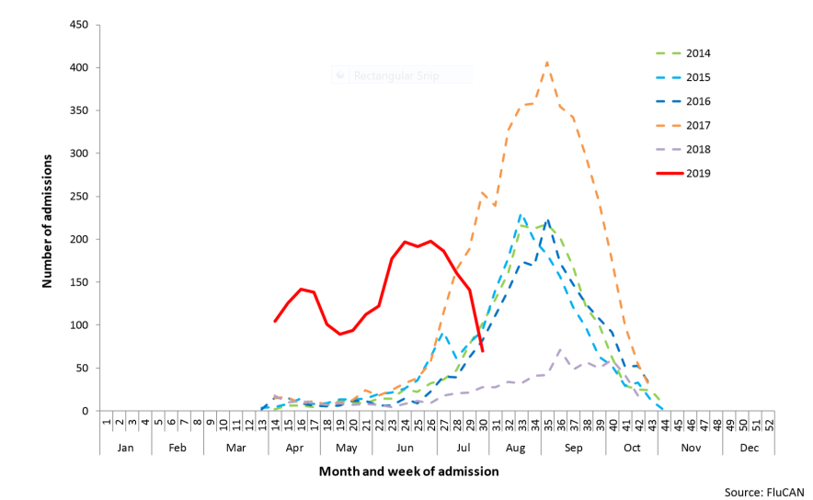
Influenza preparations (2/3)
In Australia there has been an peak of influenza illness around 2 months before the usual peak, although this appears to have stabilised during July.
Although confirmations of flu (by a lab test) have been much higher than usual the “clinical severity” has been assessed as low, and the rate of admissions per 1,000 beds has been within the historical 5 year average, although it is higher than 2018.

Slide 15
Influenza preparations (3/3)
Non-executive directors have expressed their expectation that much higher rates should be achieved.
The Trust’s Chief Nurse with the support of the Trust’s Medical Director lead the Trust’s work in respect of the flu vaccination work, and the Trust’s Chief Operating Officer leads the work to ensure we are well prepared for surges in admissions.
The focus of the 2019/20 preparations are in the following areas:
Strengthening the use of peer vaccinators and a more condensed campaign period
A more stringent model of requiring consent and opt-out
Further information to staff to dispel myths
Working with the CCG to ensure high-risk patients are vaccinated.
Same day flu testing
The use of personal protective equipment for staff treating patients with respiratory illness
Testing for staff

Slide 16
Can a study be undertaken to look at the possibility of adding A&E, Minor Injuries Units and Medical Centres to the App for the Harrogate Area. and possibly encouraging York, Leeds and Bradford to add their facilities to the App
5

Slide 17
Waitless app
Waitless is in use in the South East coastal area. This App provides information for the public about real-time waiting times in Urgent Care units across a defined geography.
To be effective it requires coverage of a number of alternative services (usually minor in jury units) in the area as it is designed to assist patients to identify the unit with the shortest waiting time within a reasonable distance.
There are a wider set of options for patients in the South East Coast which has a large number of MIUs that are accessible and reasonaby close to the major hospital A&E departments and this is why it has been introduced.
It was evaluated for possible use in West Yorkshire and Harrogate and deemed to be not cost effective for the area due to the limited alternative units available and the cost of the system.

Slide 18
Governor Questions 7th August 2019

