Slide 1
Quarter 1 review Council of Governors, 7th August 2019 Steve Russell, Chief Executive steve.russell@hdft.nhs.uk; @steve_r76

Slide 2
A summary of Q1 performance
1

Slide 3
Quarter 1
Activity
A&E in line with plan, emergency admissions 10% above plan, day cases 7% above plan, inpatients in line with plan, outpatients below plan
Leeds CCG referrals 17% lower than last year
Workforce
Absence rates remain high and our substantive recruitment is a little (13 WTE) behind plan
Agency spend within ceiling
Quality
Summary Hospital Mortality Indicator is 94, meaning there are fewer than expected deaths following admission to hospital
C-difficile rates higher than planned, but only 2 cases had lapses in care
A&E performance 94.2%, RTT 88.3% with fewer patients on the waiting list than planned, no 52 week waits, 5/8 cancer standards met; continued 2 week wait challenges (89.7%), but 62 day performance 89.1%
Finance
Met our financial plan of a deficit of £2m, and earned £0.4m PSF
Revised our capital plan
Ensuring recovery actions are in place to reduce the deficit run-rate

Slide 4
Improving assessment and treatment pathways in Harrogate to make the best use of our resources
2

Slide 5
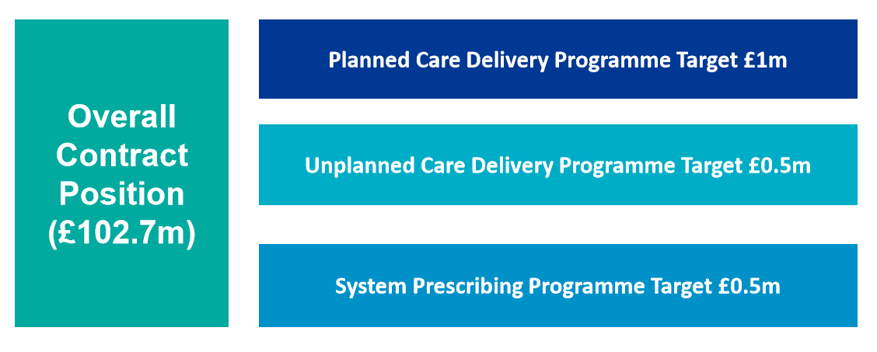
Programme of work

Slide 6
Quarter 1
Unplanned care
Objective is to manage growth within our 18/19 cost base
33% of emergency admissions managed as ‘Same day’ and 42% reduction in long length of stay through implementing;
Discharge programme, Acute Frailty, CAT expansion, a new acute medical model and a single point of contact
To date, growth accommodated within cost base, PBR cost of growth would have been 0.6m
Planned care
New local triage model
Endoscopy pathway
First contact practitioners
Follow up transformation
System prescribing
Rheumatology and Dermatology pathways
Oral nutritional supplement
Freestyle Libre introduction
Transfer of care medicines

Slide 7
A focus on teamHDFT and our culture
3

Slide 8
Update on key people priorities
Fair & Just culture
Now have three Freedom To Speak Up Guardians
Work with Deloitte has started and first phase is drawing to a close
Review of our employee relations polcies has started
Support to first line leaders
New programme commences in September in pilot phase
Learning partner pilot commences
Health & Wellbeing
Scoping work has started on a health and wellbeing offer
Inclusion as standard
Staff networks are due to launch in September
WRES and WDES submissions made
Policy on caring for transgender patients

Slide 9
Our focus during Quarter 2
4

Slide 10
Key areas of focus
Activity & Finance
Securing changes to the pathway for Leeds CCG patients who historically were referred to HDFT
Ensuring each directorate has robust plans to make the required changes to expenditure
Continuing the work on our transformation plan
Quality
Bringing together governance around GIRFT, national audits, complaints and incidents
Continuing our work on complaints
Continuing work on falls and pressure ulcers
A focus on activity, food and nutrition
Workforce
Finalise the ‘people plan’ in consultation with HDFT colleagues
Ramp up recruitment
Preparing
UCI cycling championships
Winter
Flu
EU Exit

Slide 11
Some things to celebrate
5

Slide 12
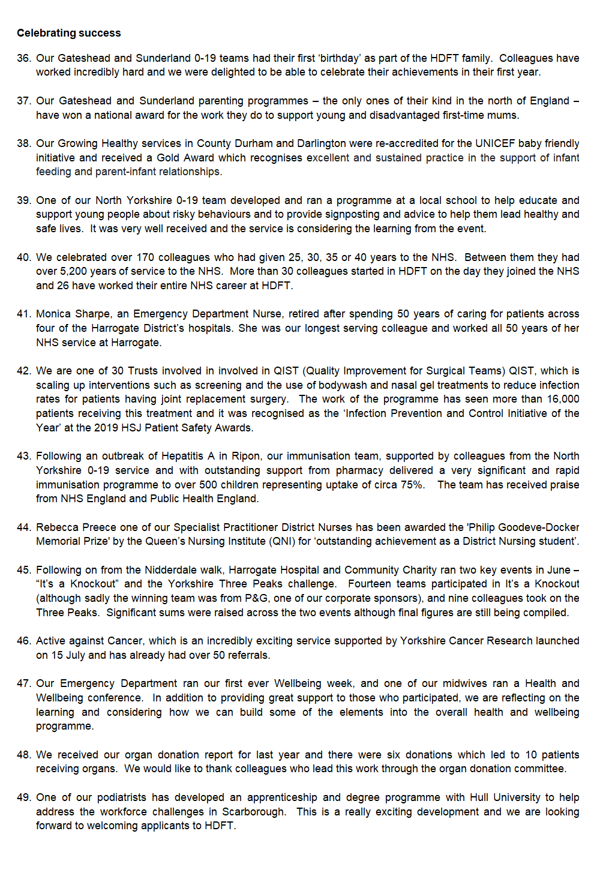

Slide 13
Questions and discussion

