Slide 1
Green Plan
Our Green Plan (2025–2028) builds on the achievements of the 2022–2025 cycle and strengthens our focus on delivery, accountability and measurable carbon reduction, supporting high-quality, resilient healthcare for the 900,000 people we serve.
Key Highlights 2025/26
  Carbon Emissions Reduction – As reported in the last reporting year, we have achieved a 51.5% reduction in direct emissions (Scope 1 & 2) against our reconstructed 1990 baseline.
  Energy Efficiency & Estates Improvements - Completion of £14.1M Public Sector Decarbonisation Scheme (PSDS) projects including heat pumps, solar PV, insulation, and optimisation of energy centres.
  Clinical Sustainability - high-impact anaesthetic gas emissions have reduced by 80% from the baseline.
  Digital Transformation - Ongoing implementation of paperless systems.

Slide 2
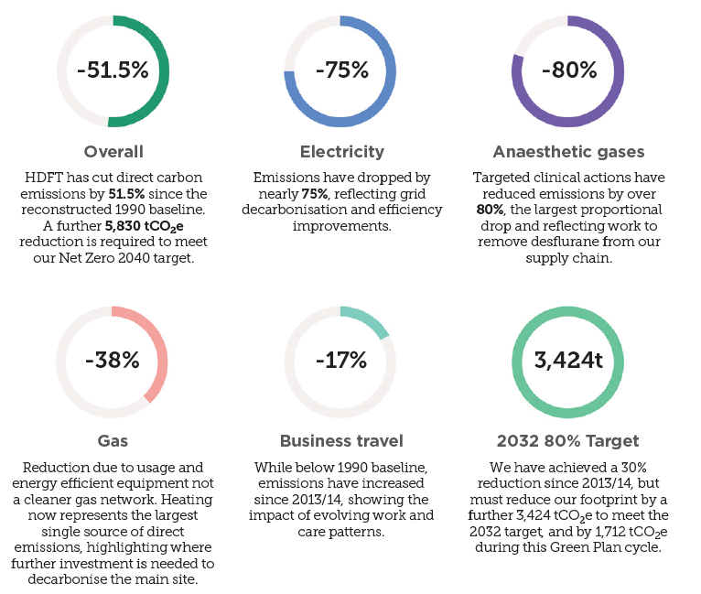
Green Plan Key Insights
Headline reductions in Scope 1 & 2 emissions by source, 1990-2024/25.

Slide 3
How do we get there? – Green Plan Priorities
Key Projects 2026/27
Sub-Metering Programme- Following successful NHS funding . This programme will provide granular energy consumption data, identify inefficiencies, support targeted interventions, and is projected to deliver a 5% reduction in electricity use across site.
Carbon Accounting Project-This year the Trust will begin implementing internal carbon-accounting software , providing annual carbon footprints, benchmarking, and targeted carbon reduction planning, especially within Scope 3 emissions.
Travel & Transport-The Trust will develop and implement a new NHS Sustainable Travel Plan, this plan will provide a framework for improving patient, staff, and visitor travel, with a clear focus on reducing our Scope 3 transport emissions.
Further Investment-£4.1M of PSDS Phase 4 investment. Providing an Air Source Heat Pump (ASHP), building fabric upgrade consisting of window replacements to reduce heat loss. An exhaust gas heat exchanger will also be installed onto the existing CHP to utilise previously wasted low-grade heat. The proposed annual carbon savings are 295tCO2e. Works are underway and project completion is March 2028.

